Slide 1
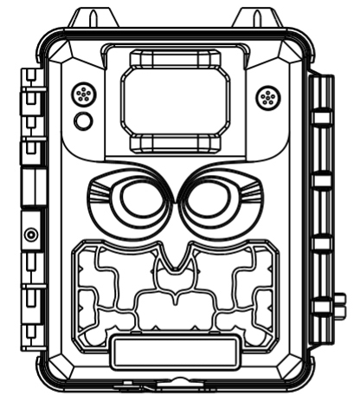
Camera General Description: This Camera is a digital scouting camera and is designed for outdoor use and is resistant against water and snow. Aim to for long duration performance in the harshest outdoor environment. It can be triggered by any movement of game in a location, detected by a highly sensitive passive Infra-Red (PIR) motion sensor, and then delivers clear photos or videos (in black & white) in the dark, and take color photos or videos in daylight. This Cam added dual lenses, one for day and one for night images. Having a dedicated night lens and built-in infrared LEDs made a noticeable difference on night pictures, producing more contrast and clarity.
Highly Recommended by Outdoor Explorers - Trail Camera with Dual Lens Camera Instruction Manual
KW591

Slide 2
Notes Before Use
1. To insert or replace the battery, SD card, firstly turn camera to OFF mode.
2. The color changing of the Indicator
1) The indicator light flashes red when it is turned on or ready for operation.
2) The indicator light flashes red when camera counts down 10 seconds to enter Working Mode
3. Batteries need to be used dry batteries, can not use rechargeable batteries. For best results use 6pcs high quality AA alkaline or AA
lithium batteries ONLY.
4. When the SD card is inserted into camera, make sure that the SD card is not in the unprotected position. SD card(Class
10 or higher up to 256GB) is recommended.
5. When using an external power supply, make sure that voltage is correct.
6. Please take out the battery for long time unused, so as to avoid leakage of the battery.
7. Camera can not be directly immersed in water, can not be placed in the environment of strong acid and alkali.
8. Finger can not press the Fresnel lens.
9. Keep the lens and battery compartment clean.
10. Do not use sharp or hard objects to attack or scratch the screen and other damage things.

Slide 3
Quick Start
Move the latches and open the front cover
Load 6pcs lithium AA or alkaline AA batteries
Insert the SD card
Switch to the ON Mode
Press MENU key to set up the camera parameters
After finishing setting, Camera counts down 10 seconds to enter Working Mode
Put it in the right position you would like and take a 10minutes test before take it to woods.
Note:
Please format your SD Card in the camera for the first time use: press MENU key to find "Format" and choose execute.

Slide 4
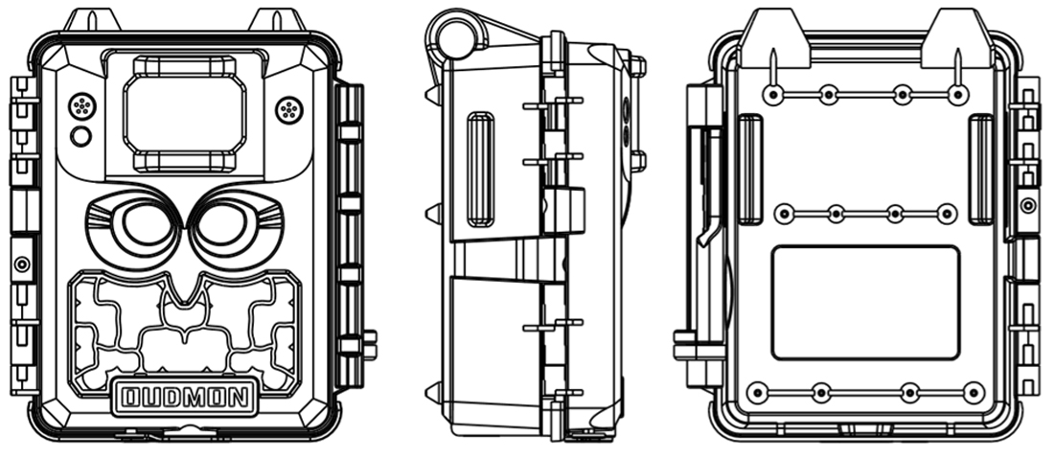
View Drawings

Slide 5
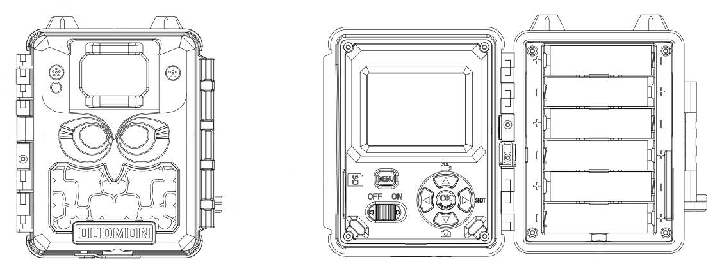
Camera Overview
PIR
Video Mic
LED Indicator
LENS
LENS
SD
IR LED
ON / OFF Key
Operation Part
Lock Catch
Battery Case

Slide 6
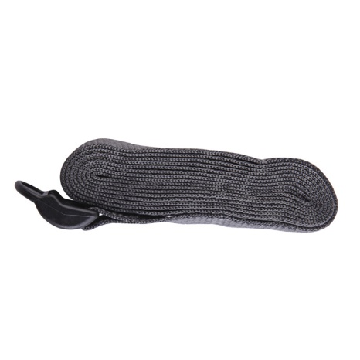
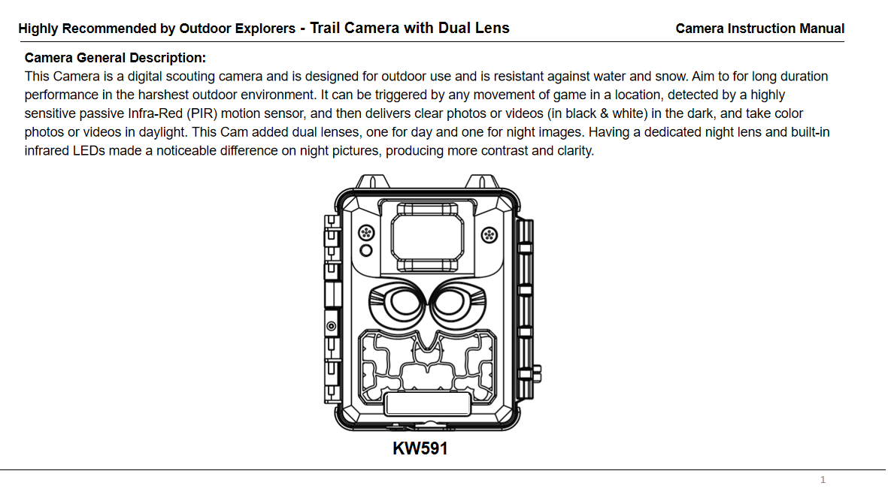
Standard Accessories
1×Belt 1×Case 1×Manual

Slide 7
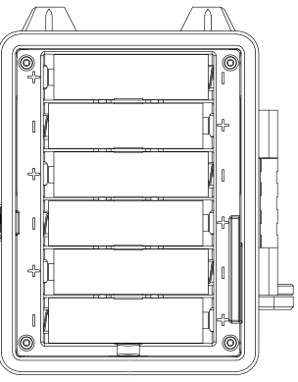
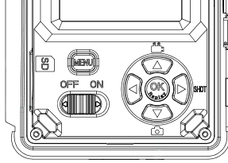
Battery Type: 6 AA For maximum battery life, we recommend using 6pcs lithium AA or alkaline AA batteries. Batteries need to be used dry batteries, can not use rechargeable batteries. Please be sure to insert each battery with correct polarity (negative or“flat”end against the long spring of each battery slot).
Power Supply
External Battery Jack: 12-volt
Optionally, you can connect an external 12 DC power source to the "DC in"jack at the bottom of the Cam.
SD Card
Insert the SD card ( OFF mode ) before beginning to operate the camera. SD card is supported up to maximum 256GB capacity. SD card (Class 10 or higher) is recommended. Note: Please format your SD Card in the camera for the first time use: press MENU key to find "Format" and choose execute.

Slide 8
●「ON」Mode Information Screen In the ON Mode you can check and change the settings of the cam with the help of built-in LCD. Once finishing setting, the Cam counts down 10 seconds to enter the Working Mode. The cam will take photos or videos automatically (according to its current parameter settings) when it is triggered by the PIR sensor′s detection of activity in the area it covers. Moving the power switch to the ON position will turn on the LCD display and you will see information screen as below. Time Scan ON Battery Level
Operational Modes
The cam has two basic operational modes: 「OFF」, 「ON」
●「OFF 」Mode
When cam in OFF mode, you can do the following:
• replacing the SD card or batteries
It will occur a little of power consumption under OFF mode. If you won't use it for a long time, please take batteries off.
Image Resolution
# of Photos Taken
Audio Rec ON
Video Resolution
Available Video
Recording Time
Camera Mode
8M
0000/0888
Remaining Photo Capacity
Video Mode
1080P
00:00:00
Time Stamp ON
T
Time Stamp ON
T
Time Scan ON
SD Card Status
Battery Level
SD Card Status

Slide 9
Settings
Set Clock
Set Clock
Press OK and use UP/DOWN keys ( to change the setting ) and LEFT/RIGHT keys ( to move to the next field ) to set the hour ( 24-hr format only, “00”=midnight,“12”=noon) and minute, then move to the next row to set the year, month and date accordingly. Once all settings are made, press OK to save.
Set
OK Set MENU Exit
Mode
Mode
Camera
Selects whether still photos or video clips are captured when the camera is triggered. Camera & Video is combines both camera and Video, so a still photo and a video clip are both captured for each trigger.
Video
Camera&Video
OK Set MENU Exit

Slide 10
Settings
Day Image Size
Day Image Size
5M
Select day image resolution among 5M, 13M and 30M. Higher resolution produces better quality images but creates larger files that will occupy more space of the SD card.
13M
30M
Set Exit
OK
MENU
Night Image Size
Night Image Size
2M
Select night image resolution among 2M, 5M and 8M. Higher resolution produces better quality images but creates larger files that will occupy more space of the SD card.
5M
8M
Set Exit
OK
MENU
Capture Number
Capture Number
Selects how many photos are taken in sequence per trigger in Camera mode. Please also refer to the interval parameter.
1
OK Set Exit
MENU

Slide 11
Settings
Video Size
Video Size
640*360
Selects video resolution (in pixels per frame). Higher resolution produces better quality videos, but creates larger files that will occupy more space of the SD card capacity (fills up faster).
1280*720
1920*1080
Set Exit
OK
MENU
Day Video Length
Day Video Length
Sets length per captured video clip. Settings begin with 10 second default when parameter is first selected. After stepping down to 5s, video length settings starts over from 60s.
10s
Set Exit
OK
MENU
Night Video Length
Night Video Length
10s
Sets length per captured video clip. Settings begin with 10 second default when parameter is first selected. After stepping down to 5s, video length settings starts over from 60s.
Note: IR LED power is very large, recommend to set to less than 15s.
Set Exit
OK
MENU

Slide 12
Settings
Camera Name
Camera Name
Allows the user to set a customized name for the camera. Very useful for identification purpose when multiple cameras are used at the same time since each camera will imprint its name on all photos (but not videos) it captures.
Input
Set Exit
OK
MENU
Interval
Interval
Selects the length of time that the camera will “wait”until it responds to any additional triggers from the PIR after an animal is first detected and remains within the sensor‘s range. 60M(minute)to 1S (Second) range of settings available. (60M-1M are set in one minute increments, 59S-1S are set in one second increments)
10s
Set Exit
OK
MENU
Sensor Level
Sensor Level
The "High" setting will make the camera more sensitive to infrared (heat) and more easily triggered by motion, and "Low" setting makes it less sensitive to heat and motion. "Normal" is for average or moderate condition. The default "Auto" Setting will allow the camera to determine the best setting if weather is expected to change significantly during the period the camera will be used.
Auto
OK Set Exit
MENU

Slide 13
Settings
Flash Mode
Flash Mode
Prevents overexposed flash photos in close range applications.
Set to “Fast Motion” or “Low” if you are getting overexposed flash photos or will place the camera at very close range to the subjects you want to photograph.
Low
Fast Motion
Long Range
Set Exit
OK
MENU
Work Period
Work Period
This parameter defines a certain time period in a day when the camera can be triggered , while in the rest of the time the device is shut off. The effective value ranges from 00:00 to 23:59 Press OK and use UP/DOWN keys ( to change the setting ) and LEFT/RIGHT keys ( to move to the next field ) to set time. Once all settings are made, press OK to save.
ON
OFF
Set Exit
OK
MENU
Format
Format
Deletes (erases) all files stored on a card to prepare it for reuse. Always format a card that has been previously used in other devices. Caution! Make sure you have downloaded and backed up all files you want to preserve first! Press OK to execute, press MENU (or select NO then press OK) to exit without formatting.
Execute
OK Set Exit
MENU

Slide 14
Settings
Time Stamp
Time Stamp
Select “ON” if you want the date & time (that the photo was captured) imprinted on every photo, select “OFF” for no imprint.
On
Off
Set Exit
OK
MENU
Time Scan
Time Scan (Time Lapse) recording mode on/off. When activated, Time Scan forces the camera to take photos or videos even when it is not triggered by an nearby live animal,useful for constant monitoring of an area that might be far away from the camera. The user can set start and stop times for up to two in dependent “blocks”of Time Scan recording,as well as the interval time between each photo/video
Time Scan
ON
OFF
Note: two time blocks can not appear in overlap section, or you will not set it successfully. For example: A 8:00-12:00 B 13:00-23:00, this is OK for set.
Set Exit
OK
MENU
Coordinate Input
Coordinate Input
Allows the user to input latitude and longfitude coordinates for the camera's location. This will be embedded jin the files saved on the camera's SD cards, (If ON is seclected).
ON
OFF
Set Exit
OK
MENU

Slide 15
Settings
Default
Default
Select“Execute”and press OK to restore all parameters to the original factory default settings. If the camera is behaving oddly and you think you may have changed the setting for something accidentally (but aren't sure which one), this will reset all parameters to their most commonly used or "generic" settings.
Execute
Set Exit
OK
MENU
Version
Version
KW591NC2D×19207
Here it shows the updated Firmware version being currently used in this camera. Make sure you download and use the most updated firmware.
Set Exit
OK
MENU

Slide 16
MOUNTING and POSITIONING
Mounting
We recommend mounting cam on a sturdy tree with a diameter of about 6 in. (15cm). To get the optimal picture quality, the tree should be about 16-17 ft(5 meters) away from the place to be monitored, with the camera placed at a height of 5-6.5 ft. (1.5~2 m). Also, keep in mind that you will get the best results at night when the subject is within the ideal flash range, no farther than 60' (19m) and no closer than 10'(3m) from the camera.
There are Two Ways to Mount Cam:
•Using the adjustable strap: Push one end of the strap through the two brackets on the back of cam. Thread the end of the strap through the buckle. Fasten the strap securely around the tree trunk by pulling the end of the strap firmly so there is no slack left.
•Using the tripod socket or mount (the user provide): The camera is equipped with a socket at the bottom end.
Sensing Angle and Distance Test
To test whether cam can effectively monitor the area you choose, this test is recommended to check the sensing angle and monitoring distance of cam.
To perform the test:
•Switch cam to ON mode.
• Make movements in front of the camera at several positions within the area where you expect game or subjects to be. Try different distances and angles from camera.
The results of your testing will help you find the best place where mounting and aiming the cam. The height from the ground for placing the device should vary with animal size appropriately. In general,3 to 6 feet is preferred. You can avoid potential false triggers due to temperature and motion disturbances in front of the camera by not aiming it at a heat source or nearby tree branches or brush (especially on windy days).

Slide 17
Playing Back/Deleting the Photos/Videos
Reviewing Images or Videos on the Cam LCD
1. Put the power switch in ON mode (switch to OFF first).
2. Push the OK (Replay) key to enter image review mode.
3. Use the UP/DOWN keys to scroll through your photos or videos. The right corner of the display will indicate "JPG" for still photos, and a film icon for video files. Press the Right (Shot) key to review a video.
4. To exit image review mode, press the OK(Replay) key.
Reviewing Images Directly from the SD Card
By removing the SD Card (swapping it for a new empty card if you like) and taking it to your home or campsite to view the images by using an SD card "reader"(user supplied) connected to your computer (some computers and TVs have a built in SD Card slot).
Press MENU to delete an image
High light the "Delete Current" or "Delete All" option, then press OK. Next, select "YES" or "No".
Note: After deleting a picture or a video file, the deleted files can't be restored! It is also possible to delete all files from the card by using the “Format” parameter.

Slide 18
Specification
Model Number | KW591
Max Pixels | 30M
Lens | Night Sensor lens (at night): f=7.00mm F/NO: 2.4 FOV=52°, HOV=42°; Day Sensor lens(at day) : f=5.00mm F/NO: 2.0 FOV=54°, HOV=43°
IR-Flash Range | IR LED: 48*940nm LEDS (25m-30m)
Display Screen | 2.4 inch HD Color Display
Image Size | Day: 30M, 13M, 5M Night: 8M, 5M, 2M
Video Size | 1920*1080; 1280*720 ; 640*360
PIR Sensitivity | PIR with 4 sensitivity levels: High/ Normal/ Low/Auto
Response Time | Picture trigger: < 0.4s, Video trigger: <0.6s
Triggering Interval | 1sec-60min programmable
Shooting Numbers | 1-9 programmable
Video Length | 5-60sec. programmable
Power Supply | 6×AA recommended; DC12V
Operating Temperature | -20-60℃（Storage temperature:-30-70℃）
Operating Humidity | 5%-90%
Waterproof | IP67

Slide 19
Troubleshooting / FAQ
Camera stops taking images or won't take image
1. Please make sure that the SD Card is not full, if the card is full the camera will stop taking images.
2. If the SD Card has its write protect switch in the lock position, the camera will not take images.
3. If you have used an SD card in another device before inserting it in your Cam, please Format the SD card in the Cam by using the "Format" parameter in Setup mode (make sure you have backed up any important files first, as formatting will erase all previous files). In some cases, other devices may change the formatting of the SD card so that it will not work properly with the Cam.

Slide 20
Warranty Card
Warranty
Model
Serial No
Date of Purchase
Your Name
Your Add
Your Tel
Warranty State
During warranty, hardware failure occurring, which caused by product itself, we will provide free maintenance service for the customer. Warranty period is 12 months from the day you purchase it. If there is a need for reparation, you should offer this warranty card, please take care of it.

