Slide 1
Highly Recommended by Outdoor Explorers - 4G Wildlife Scouting Cam Instruction Book
This cam is the best-selling scouting camera which is designed for activity and is resistant against water and snow. It is equipped with built-in infrared sensor, so that it can be triggered accurately by heat sources, then take high quality pictures or videos. Please refer to the notes below to ensure that you are completely satisfied with this product.
Contents
Prepar Before Start Wireless Setting/Quick Start Notes before use
View Drawings
Camera Overview
Standard Accessories
Power Supply
SD Card
Operational Modes
Settings
Software in APP
Mounting and Positioning
Specification
Warranty Card
2
3
4
5
6
7
7
8
9-16
17-23
24
25
26

Slide 2
Prepar Before Start Wireless Setting
Quick Start
Pen and paper: record relevant information such as APN and ICCID.
Mobile phone: the operator's APN information should be checked in the mobile phone.
3. 4G SIM card、large card frame、card pin: check the ICCID number on the card and write it down, then install the SIM into the camera.
Email: for receiving "NETWORK" files.
Blank SD card: store "NETWORK" files.
Computer: it is used to edit the "NETWORK" text file and store it on the SD card.
※ Move the latch and open the camera case
※ Load 12 lithium AA(non-rechargeable) or alkaline AA batteries
※ Set "NETWORK" via APP/PC and copy it to SD card
※ Insert the SD card
※ Insert the SIM card
※ Switch to the SETUP Mode,wait about 1Minute
※ Press " UP " key to select Camera or Video Mode
※ Press " MENU " key to setting camera function
※ Press " LEFT" key to take a photo and send it to your APP
※ Switch to the ON Mode
※ Close the case and position the camera for use

Slide 3
Notes Before Use
When setting camera parameters, please put camera in Setup mode.
Do not set the camera directly from ON to Setup.
To replace the battery, SD card, and SIM card, firstly turn camera to OFF mode.
Color of Indicator
When camera is updating firmware, indicator light flashes green.
The indicator light flashes red when it is turned on or ready for operation.
low battery, the indicator light flashes blue.
long standby time, the indicator flashes purple.
Batteries need to use dry batteries, do not use rechargeable batteries.
When the SD card is inserted into camera, make sure that the SD card is not in lock state.
When using an external power supply, make sure that voltage is 12V.
Please take out the battery to avoid leakage of the battery if camera is not used for a long time.
Camera can not be directly immersed in water, can not be placed in the environment of strong acid and alkali.
Don’t use your fingers to press the Fresnel lens.
Keep the lens and battery compartment clean.
Do not use sharp hard objects to scratch screen.

Slide 4
Camera Overview

Slide 5
Standard Accessories
1×Belt 1×USB
Other Accessories (not included)
1×Case
1×Manual
1× Security Case
1×External battery connection wire
1×Micro-Lens 1×Wide-angel Lens
1×5M Antenna
1×Cradle Head
1×solar panel

Slide 6
Power Supply
After opening the latch on the right side of the camera, you will see that it has 12 battery slots. For maximum battery life, we recommend using 12 lithium AA or alkaline AA batteries.
Please be sure to insert each battery with correct polarity (negative or“flat”end against the long spring of each battery slot).
SD Card / SIM Card
Insert the SD card and SIM card ( Camera being under OFF mode ) before beginning to operate the camera. SD card is supported up to maximum 64GB capacity.
64GB
SIM

Slide 7
Operational Modes
The cam has three basic operational modes: 「OFF」, 「ON」 and 「SETUP」
「OFF 」Mode
When cam in OFF mode, you can do the following:
replacing the SD card or batteries
connecting cam with other device via USB port
「ON」Mode
Once in ON mode no manual controls are needed or possible (the control keys have no effect). The cam will take photos or videos automatically (according to its current parameter settings) when it is triggered by the PIR sensor′s detection of activity in the area it covers.
「SETUP」Mode
In the SETUP mode you can check and change the settings of the cam with the help of built-in LCD. Moving the power switch to the SETUP position will turn on the LCD display and you will see an information screen.
Image Resolution
Video Resolution
Available Video
Recording Time
Signal
of Photos Taken
Audio Rec ON
Camera Mode
Time Stamp ON
5M
0000/0888
Video Mode
1080P
T
T
Time Scan ON
SD Card
Battery Level

Slide 8
Settings
Set Clock
Press OK and use UP/DOWN keys ( to change the setting ) and LEFT/RIGHT keys ( to move to the next field ) to set the hour ( 24-hr format only, “00”=midnight,“12”=noon) and minute, and then (on the lower row ),the year,month and date. Once all settings are made, press OK to save.
Set Clock
Set
OK Set
MENU
Exit
Mode
Camera
Video Dual
Selects whether still photos or video clips are captured when the camera is triggered. “Dual”=Camera+Video
Mode
OK Set
MENU
Exit
Image Size
5M
16M
30M
Selects resolution for still photos from 5 to 30 megapixels. Higher resolution produces better quality photos, but creates
larger files that take up more of the SD card capacity.
Image Size
OK Set
MENU
Exit

Slide 9
Settings
Capture Number
Selects how many photos are taken in sequence per trigger in Camera mode.This setting affects photos taken in Field Scan mode as well.
Capture Number
9
OK Set MENU
Exit
Video Size ze
640*360
1280*720
1920*1080
Selects video resolution (in pixels per frame). Higher resolution produces better quality videos, but creates larger
files that take up more of the SD card capacity (fills up faster).
Video Size
OK Set MENU
Exit
Video Length
Sets length per captured video clip. Settings begin with 10 second default when parameter is first selected. After going down to 5s, video length choice starts over at 60s.
Video Length
5s
OK
Set
MENU
Exit

Slide 10
Settings
Camera Name
Allows the user to set a custom name for the camera. Useful for ID purposes when multiple cameras are setup, since each camera will imprint its name on all photos (but not videos) it captures.
Camera Name
Input
OK Set MENU Exit
Interval
You can choose 1s~59 or 1m~60m.Selects the length of time that the camera will“wait”until it responds to any additional triggers from the PIR after an animal is first detected and remains within the sensor's range.
During this period of time user set“ignore triggers”interval, the camera will not capture photos/videos.This prevents the card from filling up with too many redundant images.
Interval
10s
OK Set Exit
MENU
Sync Coordinate
Set it in mobile APP

Slide 11
Settings
Work Period Set
Press OK and use UP/DOWN keys ( to change the setting ) and LEFT/RIGHT keys ( to move to the next field ) to set time. Once all settings are made, press OK to save. Only during the set work period camera will be triggered to take images/videos.
Time Scan (Time Lapse) recording mode on/off. When activated, Time Scan forces the camera to take photos or videos even when it is not triggered by an nearby live animal,useful for constant monitoring of an area that might be far away from the camera. The user can set start and stop times for up to two in dependent “blocks”of Time Scan recording,as well as the
interval time between each photo/video.
Interval: 1m~59m or 1h~6h
ON OFF
Work Period Set
OK Set MENU Exit
Time Scan
ON OFF
Time Scan
OK Set MENU Exit
Sensor Level
Four kinds of choice:Auto, Low, Normal, High.
The default “Auto” setting will allow the camera to determine the best setting based on its current operating temperature. This is an ideal setting if the weather is expected to change significantly during the period the camera will be used.
The Low setting is recommended in cold weather; the High setting is recommended in hot weather.
Sensor Level
Auto
OK Set MENU Exit

Slide 12
Settings
Password
Select”ON”If you want to protect your camera with a password. Once password is set, whenever you turn on the camera, you will need to enter a four-digit password. Select “OFF” for no protect with a password.(Please remember your password.) Once all settings are made, press OK to save.
ON OFF
Password
OK Set MENU Exit
Image Recycle
ON OFF
When the SD card memory is full, it will automatically make your new file overwrite the previous files. Please download the picture in time and choose carefully.
Image Recycle
OK Set MENU Exit
Time Stamp
Time Stamp
(only affects
photos)
ON OFF
Select “ON” if you want the date & time imprinted on every photo, select “OFF” for no imprint.
OK Set MENU Exit

Slide 13
Settings
Video Sound
ON OFF
Select “On” to record audio along with the video when the camera is set to video mode (saved file sizes will be slightly larger). Press OK to save.
Video Sound
OK Set MENU Exit
Wireless
ON OFF
This choice is about wireless function ON/OFF. If you want to send photo to you mobile phone's APP or email, please turn it on.
Wireless
OK Set MENU Exit
TransmitFrequency
This choice is about how frequently you would like the camera to send images to you. To save battery life, you may choose Weekly.
Immediately
Transmit Frequency
Daily
Weekly
OK Set MENU Exit

Slide 14
Settings
Language
English
Selects user's preferred language from all ten languages.
English,French,German,Italian,Russian,Finnish,Spanish,Slovak,simplified Chinese,Chinese Traditional.
Language
OK Set Exit
MENU
Format
Deletes (erases) all files stored on a card to prepare it for reuse. Always format a card that has been previously used in other devices. Press OK to execute, press MENU (or select NO then press OK) to exit without formatting.
Format
Execute
OK Set MENU
Exit
Default
Select“Execute”and press OK to restore all parameters to the original factory default settings.
Default
Execute
OK Set
MENU
Exit

Slide 15
Settings
FirmwareVersion
ICCID:
123456789123456789
IMEI:123456789123456
This Page shows Modem, Sim card , and camera firmware information.
Firmware Version
OK Set
MENU
Exit

Slide 16
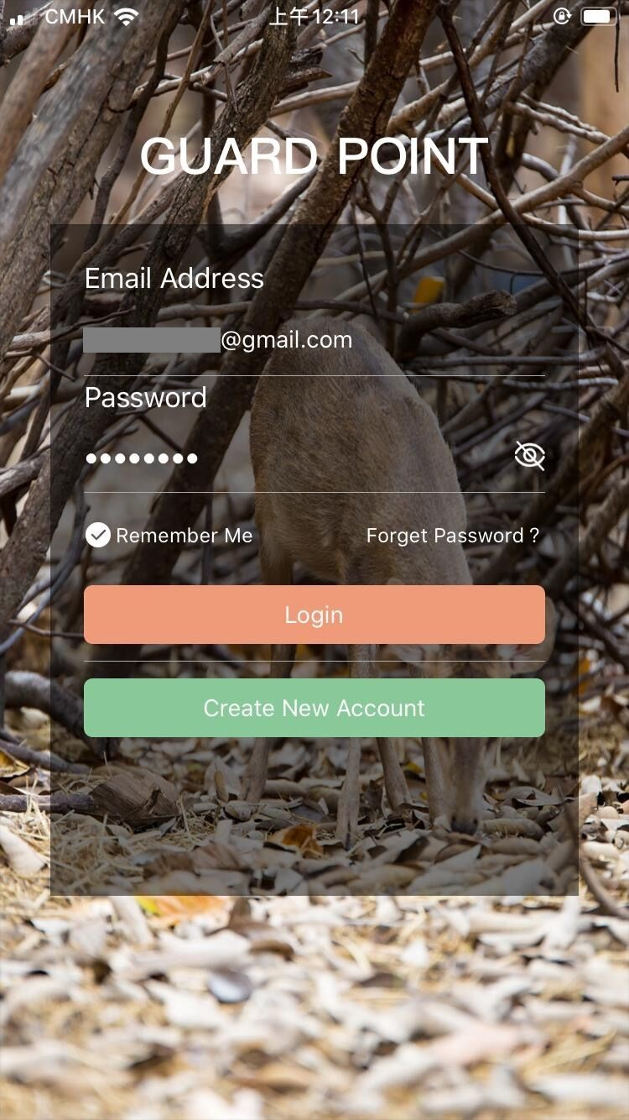
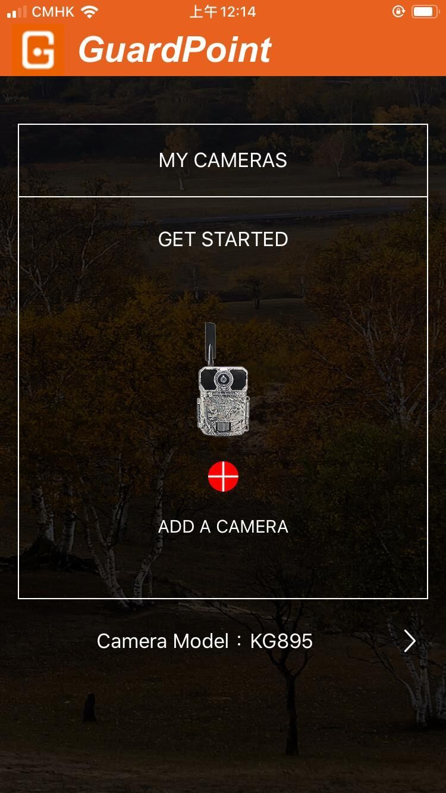
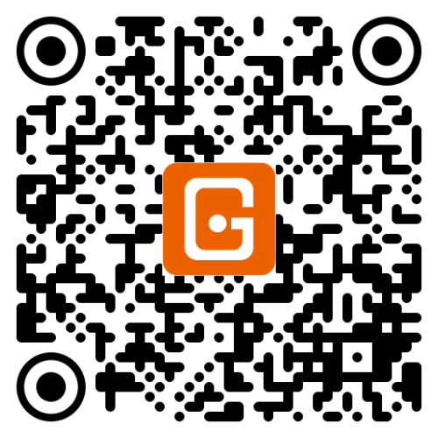
Settings in APP
1)SETUP APP
Search GUARDPOINT
in APP store, or scan below the code,then install the APP
2）Account registration
ADD A CAMERA
IOS APP
Android APP

Slide 17
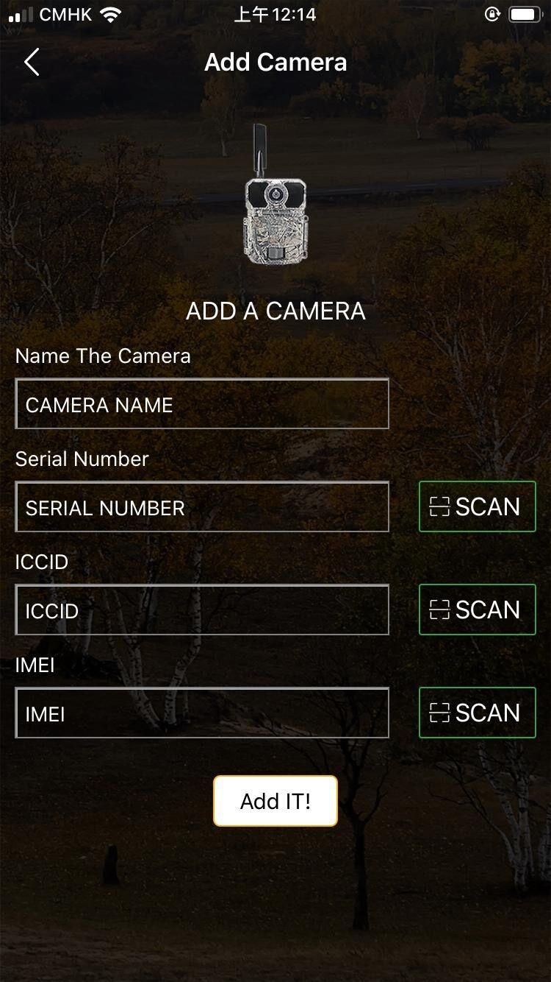
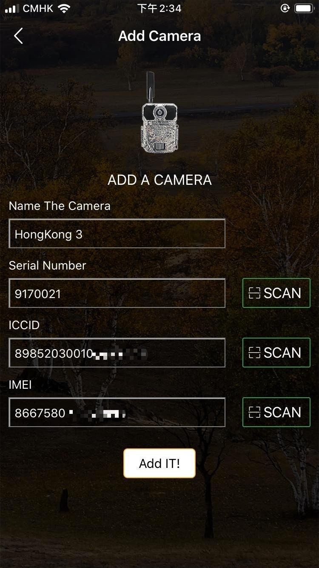
Settings in APP
3)ADD A CAMERA
FirmwareVersion
ICCID:
123456789123456789
IMEI:123456789123456
Serial Number:
Find it on the camera
ICCID:
Find it in camera's MENU
IMEI:
Find it on the camera
OK Set
MENU
Exit

Slide 18
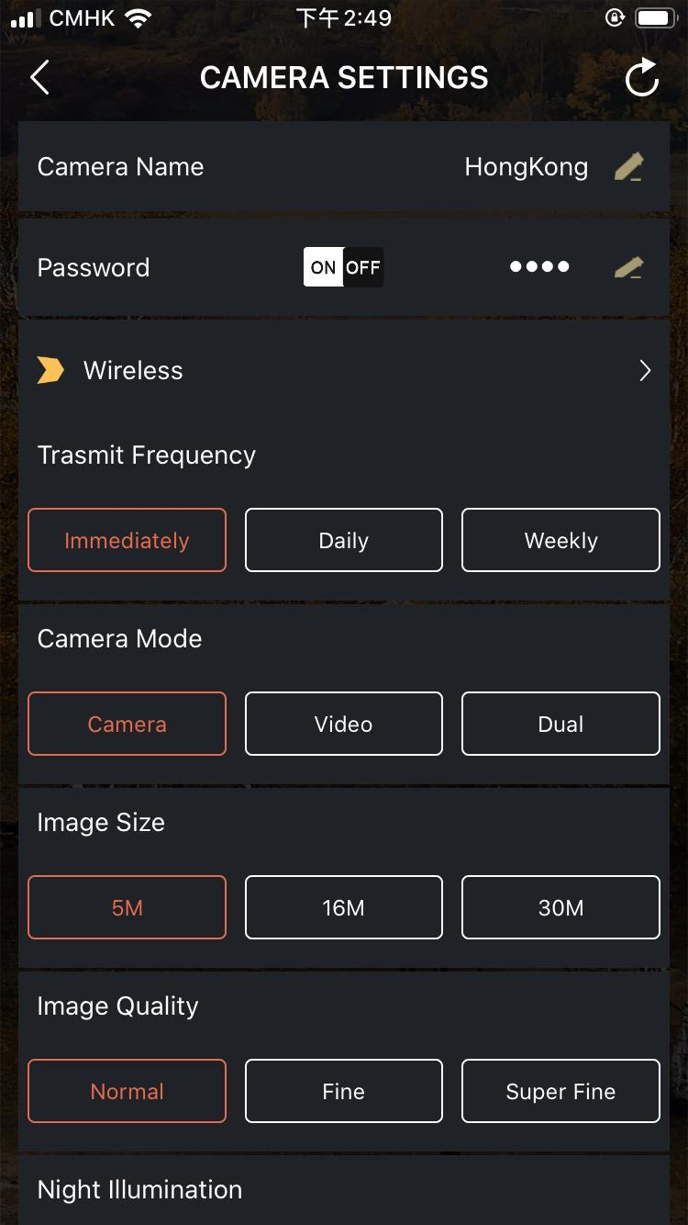
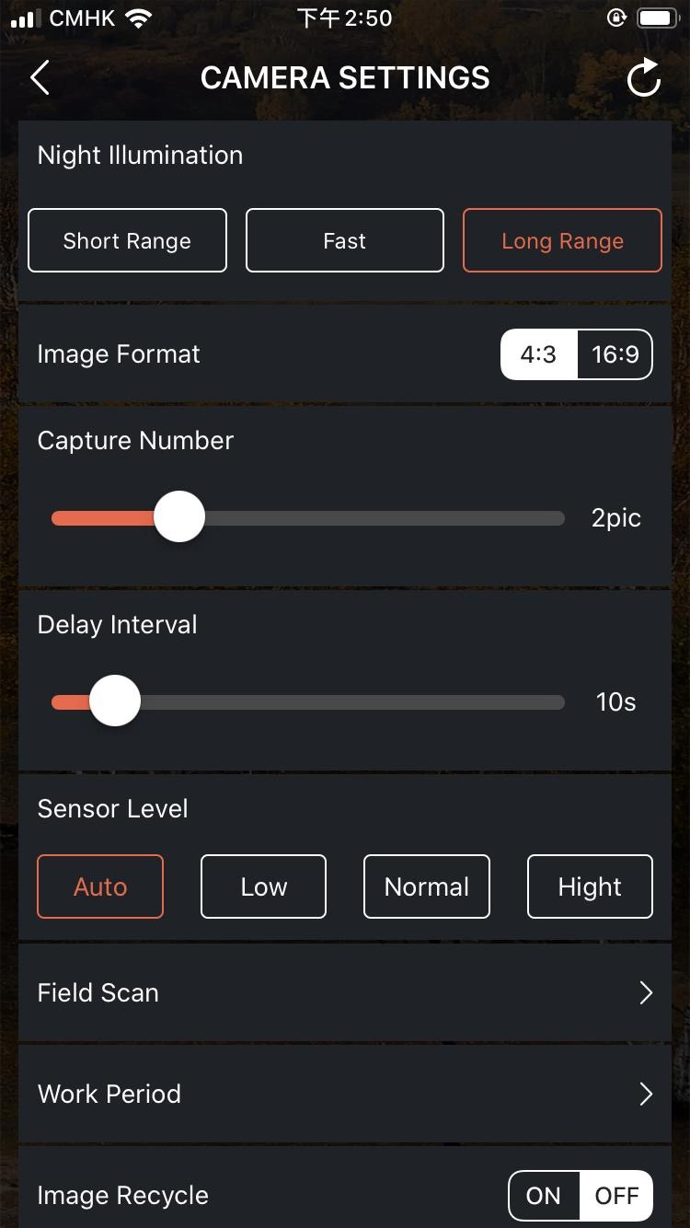
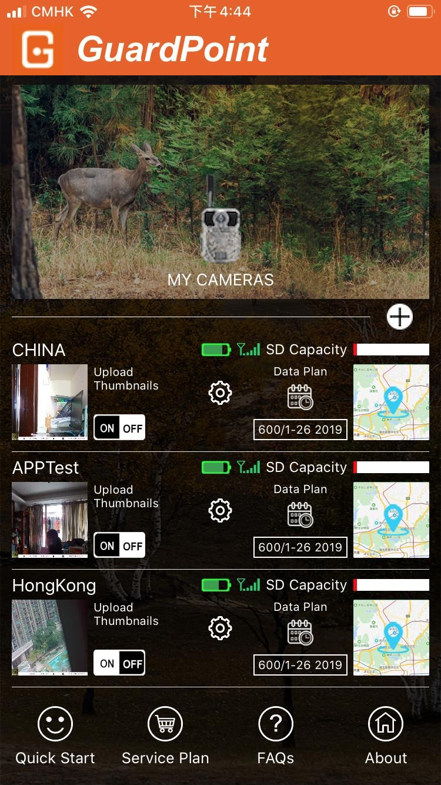
Settings in APP
4)Camera Settings
Please remember to SAVE the Settings after each modification.

Slide 19
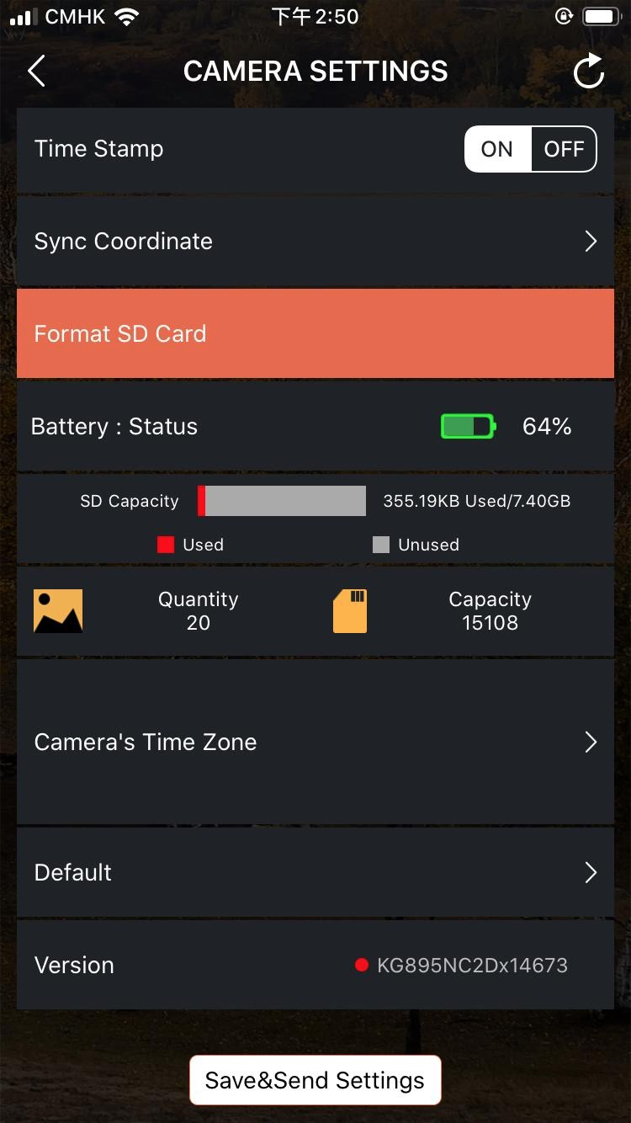
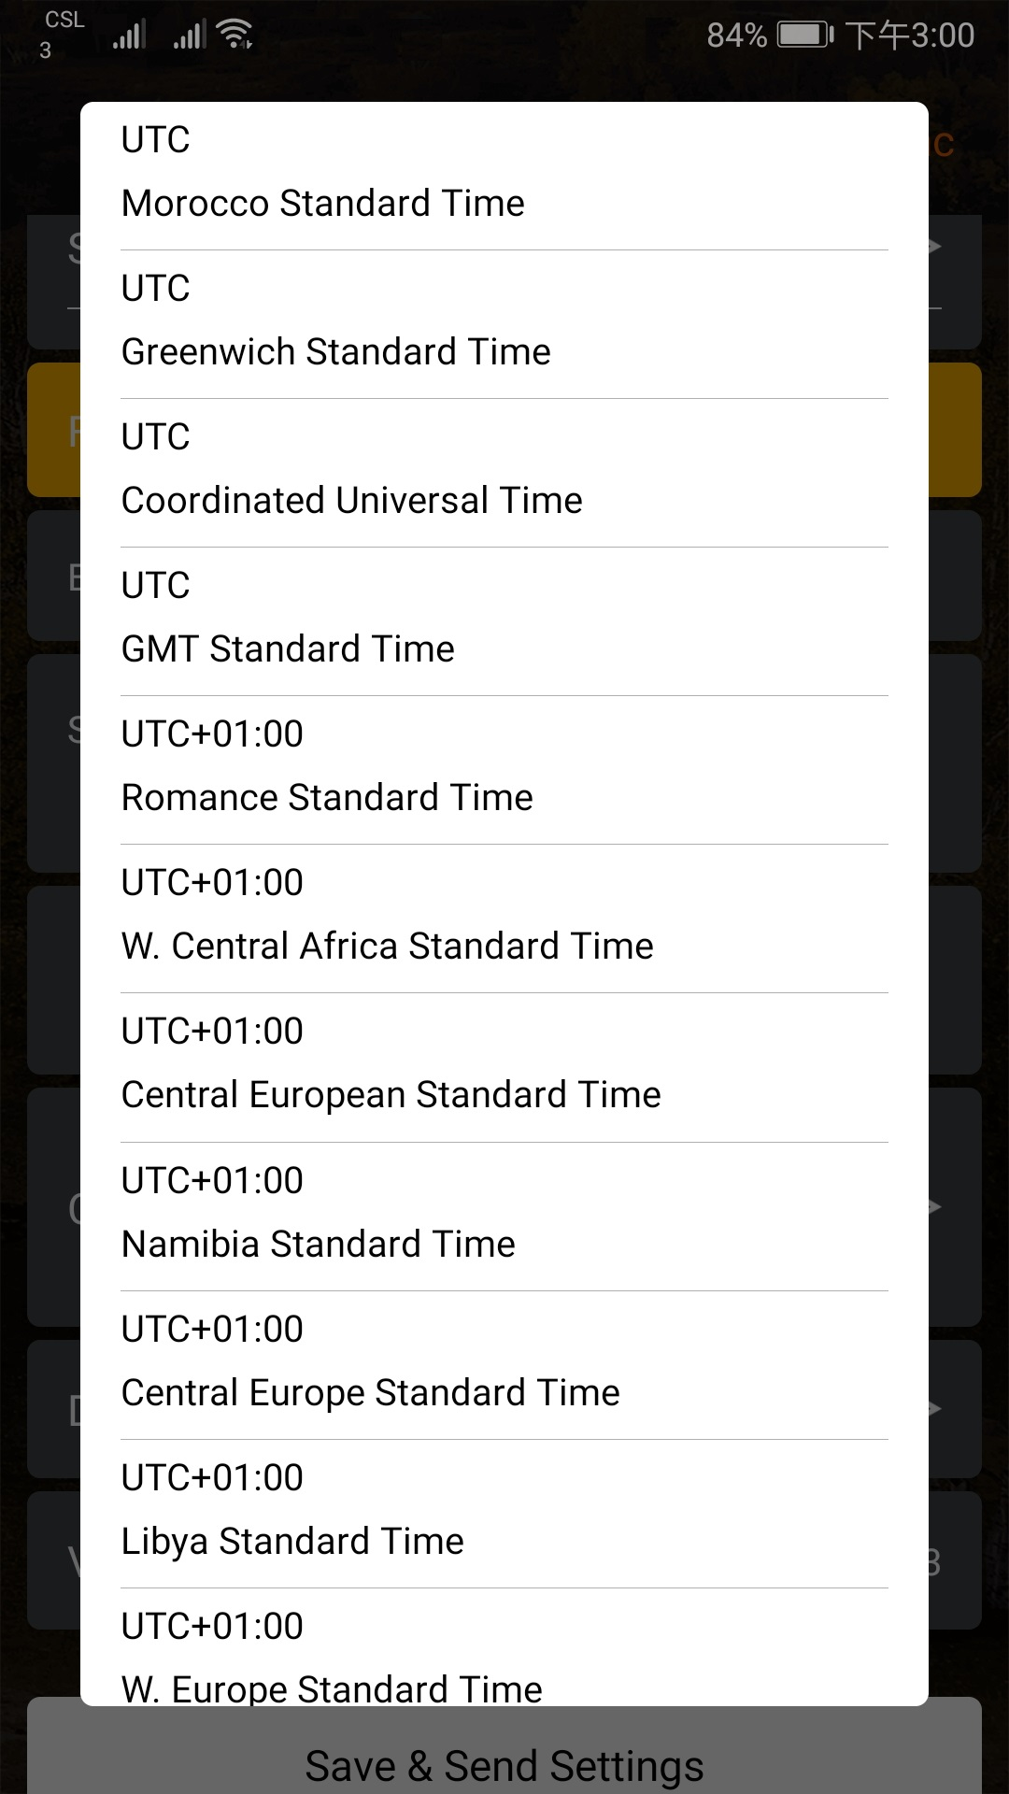
Settings in APP
Camera Settings\
Camera's Time Zone
Please select the time zone of your country.
Please remember to SAVE the Settings after each modification.

Slide 20
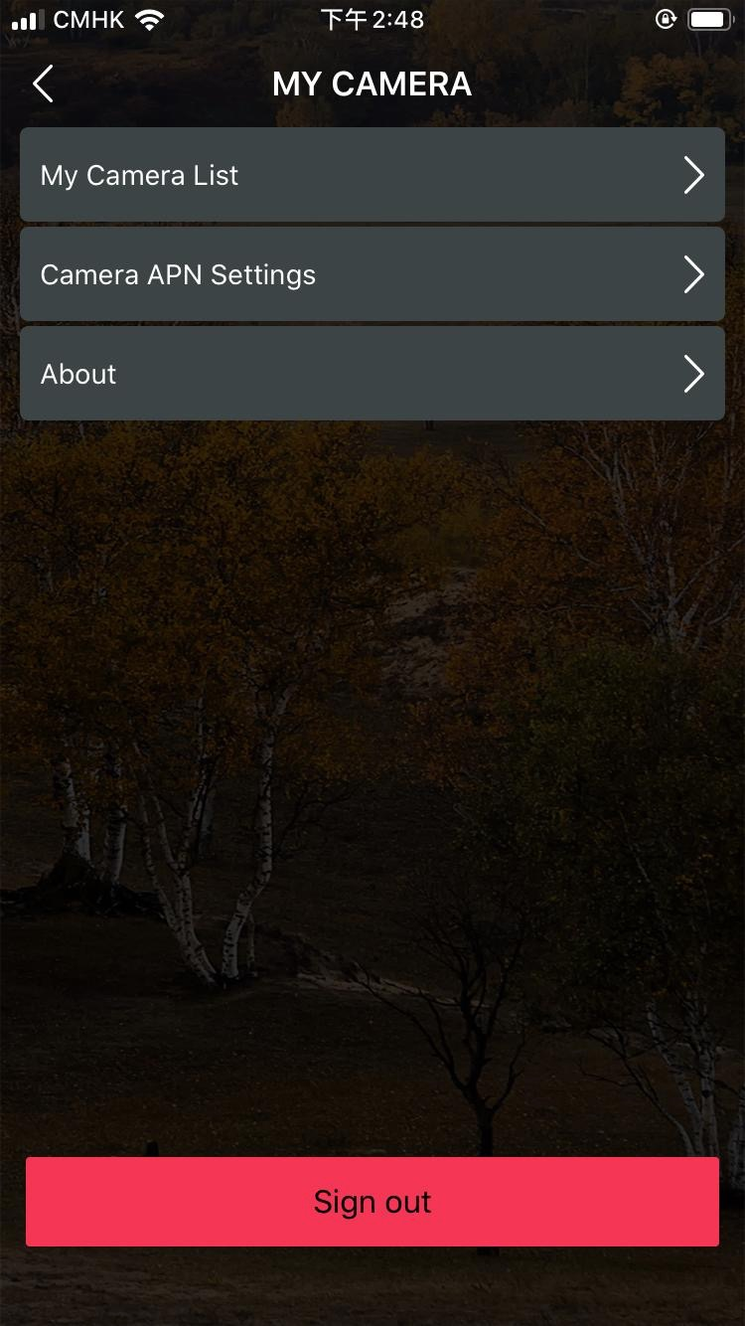
Settings in APP
5)Main Page
Quick Start
Service Plan
FAQs
About
ADD More Cameras
ON is not valid
ON is valid

Slide 21
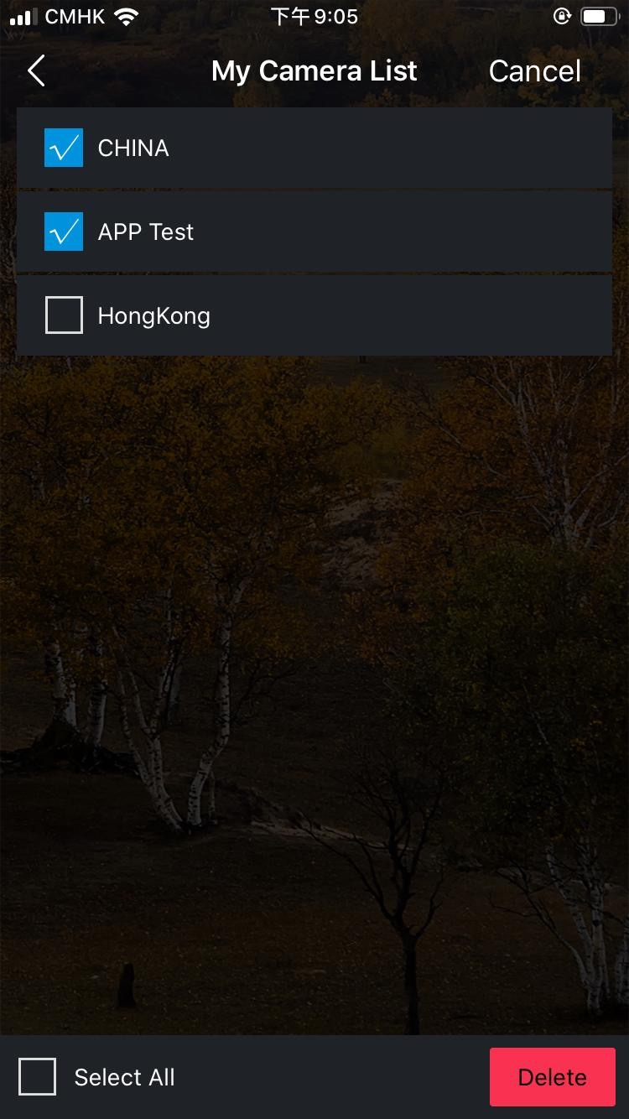
Settings in APP
6)My Camera List
When you change your phone or account, be sure to remove the unwanted camera here.
Before removing the camera, please don’t forget to download the required pictures. Otherwise, you will lose those pictures forever.

Slide 22
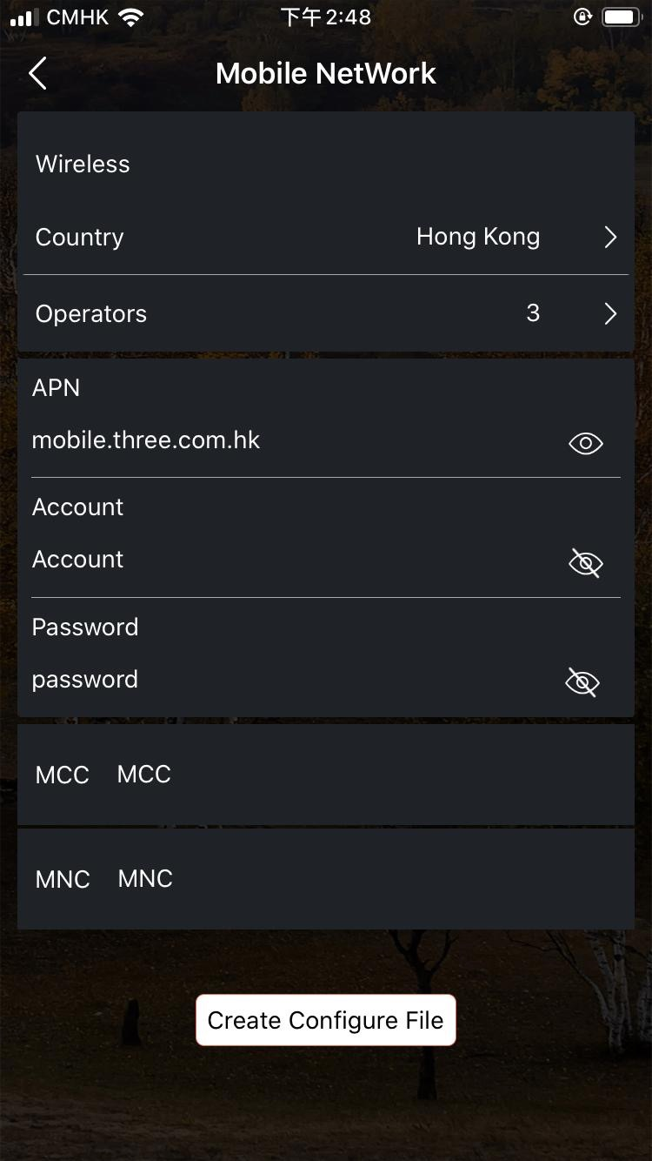
Settings in APP
7)Camera APN
Settings
If you need to add more cameras, you can quickly make a NETWORK file here, the file will be sent to your registration email, you download the file and put it on the SD card, put the SD card in the camera, you can complete the camera registration.

Slide 23
MOUNTING and POSITIONING
Mounting
Optimum height：5-6.5 inch（1.5-2 m）
Optimum distance：60inch（9m）- 10inch（3m）
There are two ways to mount cam: using the provided adjustable web belt, or the tripod socket.
Using the adjustable web belt: Push one end of the belt through the two brackets on the back of cam. Thread the end of the strap through the buckle. Fasten the belt securely around the tree trunk by pulling the end of the strap firmly so there is no slack left.
Using the tripod socket:The camera is equipped with a socket at the bottom end.
Sensing Angle and Distance Test
Totest whether cam can effectively monitor the area you choose, this test is recommended to check the sensing angle and monitoring distance of cam. Toperform the test:
Switch cam to SETUP mode.
Make movements in front of the camera at several positions within the area. Try different distances and angles from camera.
If indicator LED light flash, it indicates that position can be sensed.
The results of your testing will help you find the best place where mounting and aiming the cam. The height from the ground for placing the device should vary with animal size appropriately. In general,3 to 6 feet is preferred. You can avoid potential false triggers due to temperature and motion disturbances in front of the camera by not aiming it at a heat source or nearby tree branches or brush (especially on windy days).

Slide 24
Specification
Lens | f=7.36mm F/NO:2.8 FOV=55°; Auto IR-Cut-Remove (at night)；Support micro lens: 450mm
Trigger Time | <0.25s
Mode | Camera; Video; Dual
Image Size | 5MP;16MP;30MP
Capture Number | 1-9
Video Size | 640*360; 1280*720;1920*1080
Video Length | 5s-60s
Camera Name | Input
Interval | 1s-60m
Coordinate Input | Set it in mobile's APP
Time Stamp | On
Work Period Set | ON; OFF
Timed Scan | 2X;Interval: 1m~59m or 1h~6h
Video Sound | On
Format | Execute
Default Set | Execute
Language | English, Français, Español, Deutsch, Italiano,Pусский, Suomalainen, Slovak,Turkish,繁體中文, 简体中文

Slide 25
Warranty Card
Warranty
Model
Warranty State
Serial No.
During warranty, hardware failure occurring, which caused by product itself, we will provide free maintenance service for the customer. Free warranty is for the first year. If there is a need for repair, you should offer this warranty card, please take care of this card.
Date of Purchase
Your Name
Address
Tel No.

