Slide 1
魔眼2号产品宣传
Mold Monitor
Another Name：Mold Protector
---Active Participant in Industry 4.0
MoldEye II
We perform visual inspection, and we believe in "Seeing is Believing"

Slide 2
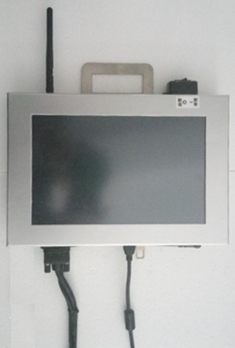
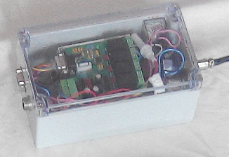
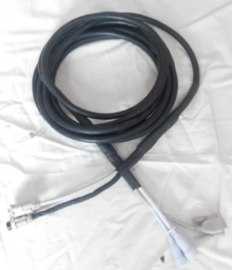
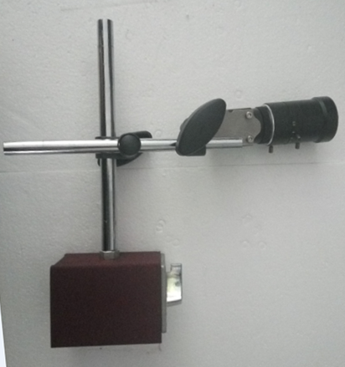
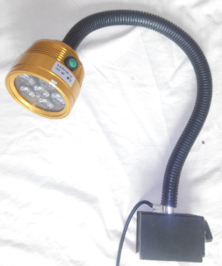
Component Overview
Main Unit: 10-inch
Controller: Self-developed
Industrial Camera: Stable performance, Equipped with 1.3MP-5MP HD wide-range lens
Light Source: Magnetic Mount, Infrared
High-speed Composite Cable

Slide 3
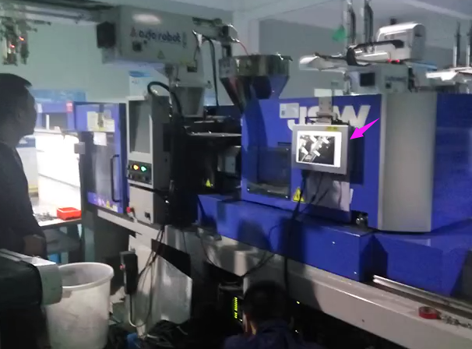
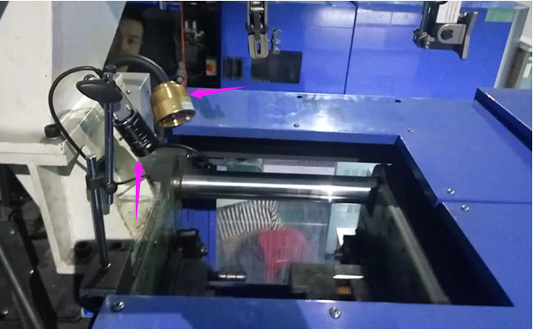
Installation in Real Applications
Mounted on Injection Molding Machine

Slide 4
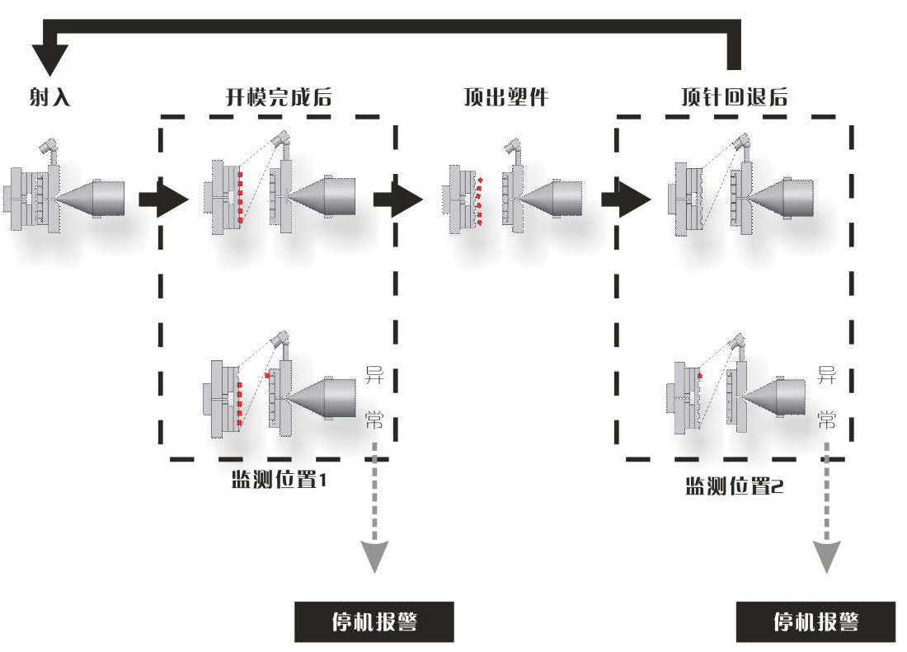
FAQ (Frequently Asked Questions)
Operational Mechanism 1 - Process Flow
1.When the injection molding machine completes mold opening, it signals the mold protector to take photos. If no abnormality is detected, the injection molding machine proceeds to the next step.
2.After the ejector pins push out the product, the injection molding machine signals the mold protector to take photos again. If no abnormality is detected, the injection molding machine continues with mold closing and other operations.
3.If any abnormality is detected, the mold protector will send an abnormal signal, stop the injection molding machine's operation and trigger an alarm.

Slide 5
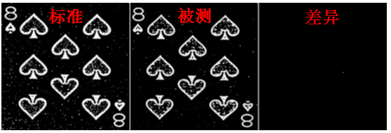
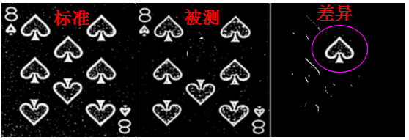
客户疑问解答
Operational Principles 2 - Image Computation
Advanced Analysis System:
1.Employs Big Data Fuzzy Analysis methodology
2.Tracks and records operator behavior patterns
3.Monitors machine status variations
4.Performs comprehensive data analysis
5.Builds and optimizes self-learning database
6.Adapts to behavioral changes over time
Provides AI-driven OK/NG decisions
7.Features flexible computing architecture"
Compared with Image Database: No significant deviation, Determined as OK
Significant deviation detected - Tentatively marked as NG, pending final determination based on operator behavior metrics.

Slide 6
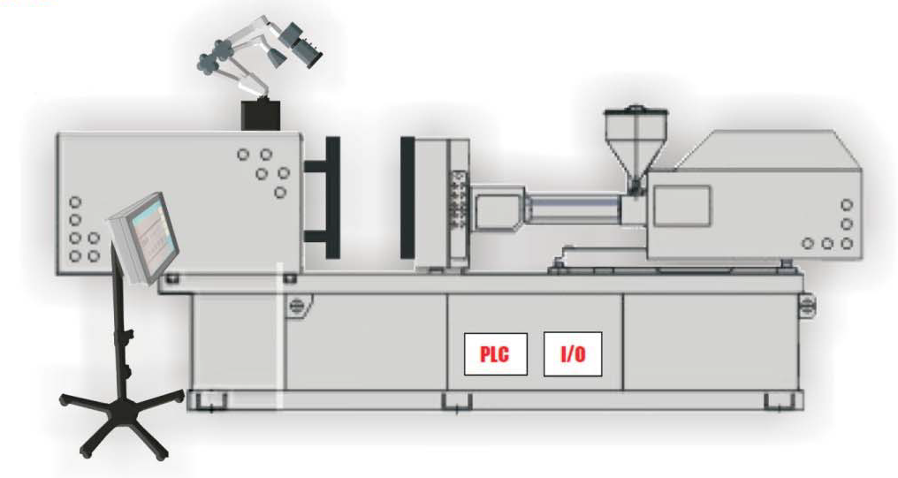
Functions and Applications
Functions
1. User-friendly HMI with 30-minute learning curve
2. Rapid 2-minute mold setup protocol
3. Space-efficient wall-mount design

Slide 7
Applications
Functions and Applications
This product can perform the following functions or any combination thereof in suitable applications:
1.Position Monitoring ◆ Slider position verification ◆ Ejector pin return confirmation ◆ Insert placement validation
2.Component Integrity ◆ Ejector pin breakage detection ◆ Multiple cavity presence checking ◆ Multi-color injection accuracy verification
3.Quality Inspection ◆ Material shortage detection ◆ Flash/burr identification ◆ Complete demolding verification
4.Process Optimization ◆ Minimizes unnecessary ejector movements ◆ Prevents consecutive defective products ◆ Reduces mold release agent usage ◆ Suitable for difficult-to-demold products

Slide 8
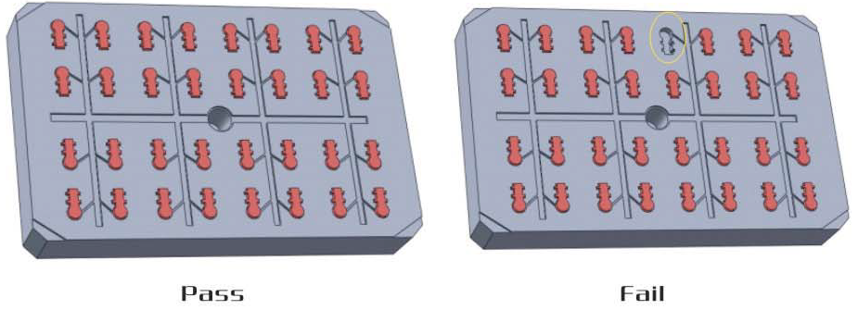
Functions and Applications
Application Example
1、Stationary Mold Residual Part Detection
When molded parts remain in the stationary mold, a cavity forms on the moving mold side. This cavity will be detected by the mold protection system, triggering an alarm.

Slide 9
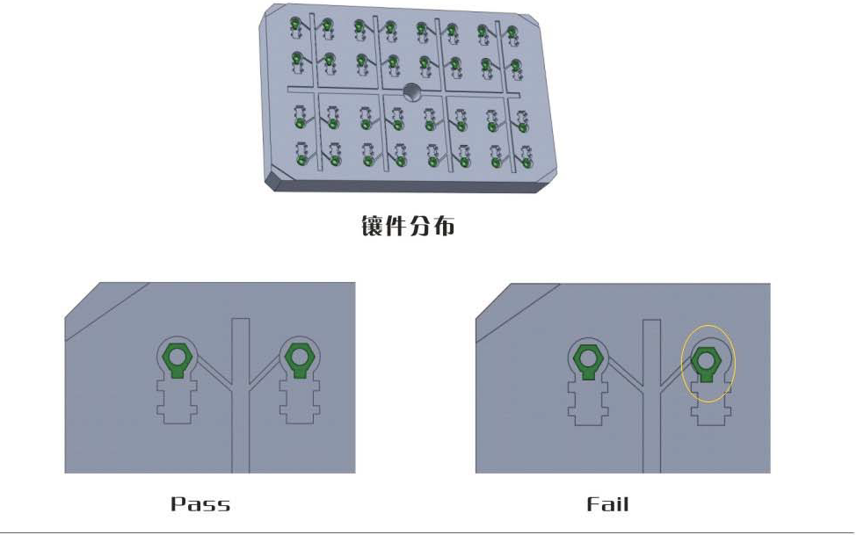
Functions and Applications
Application Example
2. Insert Monitoring System ◆ Automatic insert detection during molding process ◆ Validates correct insert quantity ◆ Confirms proper insert positioning

Slide 10
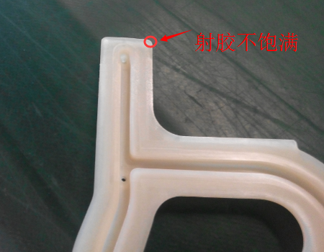
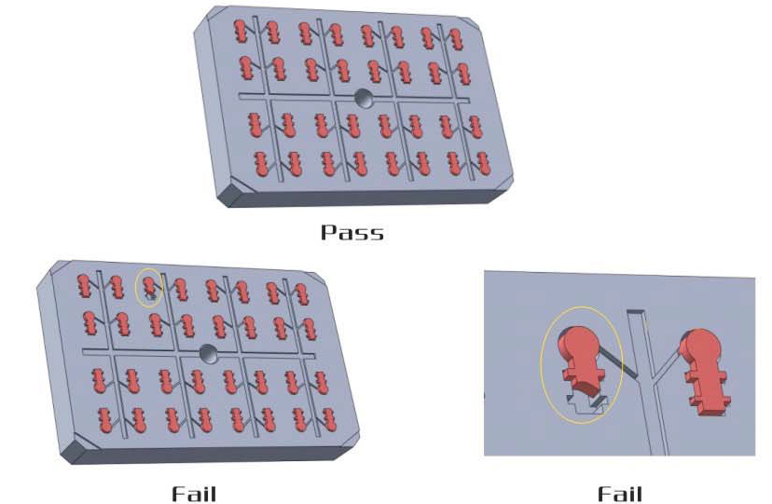
Functions and Applications
Application Example
3、Short Shot Detection
When insufficient filling occurs, it affects both the product shape and surface finish.
For large molded parts, short shots often occur at specific points. The Magic Eye 2 can focus monitoring on these critical points.

Slide 11
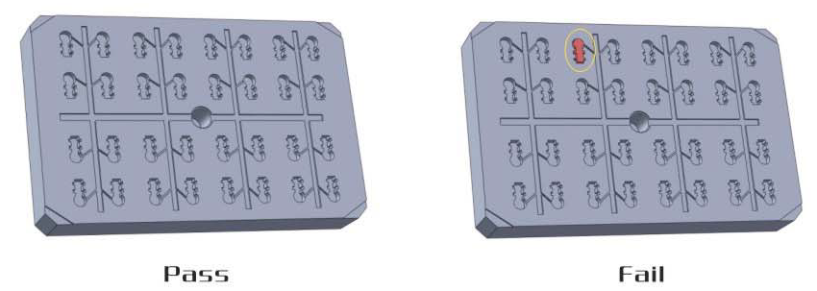
Functions and Applications
Application Example
4、Failed Part Ejection Detection
When products fail to drop after one or multiple ejection attempts, closing the mold becomes extremely hazardous, especially for high-value molds. At this critical moment, the mold protection system intervenes by issuing a mold-closing prohibition signal, preventing costly mold damage.

Slide 12
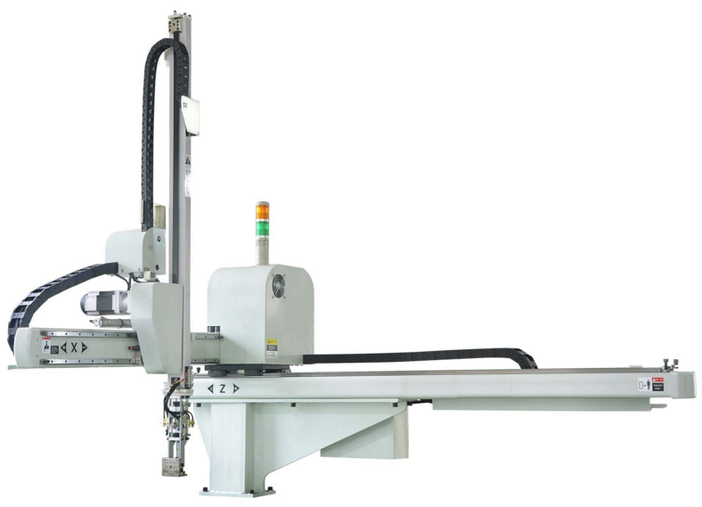
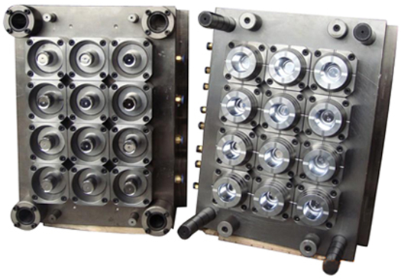
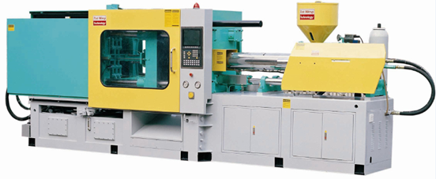
Cooperation
We specialize in software development and seek strategic partnerships:
1.Business Scope: ◆ Core Focus: Software Development Excellence ◆ Seeking Partners for: Business Development, Installation, Commissioning, After-sales Service
2.Ideal Partners: ◆ Injection Molding Robot Manufacturers ◆ Injection Molding Machine Suppliers ◆ Mold Manufacturers & Dealers
3.Partnership Benefits: ◆ Scientific Cooperation Model ◆ Mutual Protection Mechanisms ◆ Win-Win Business Structure ◆ Synergistic Value Creation (1+1>2)

