Slide 1
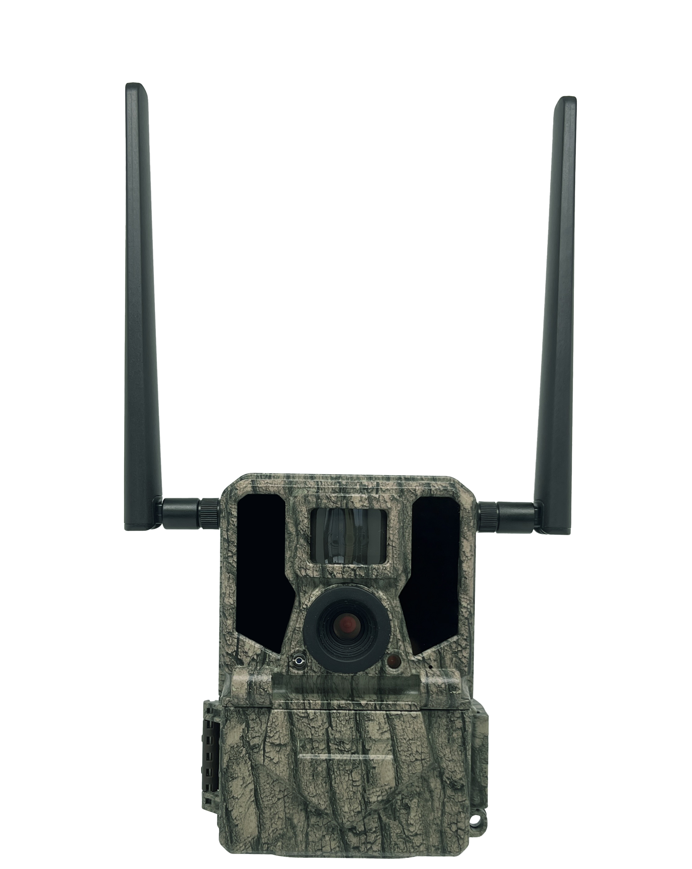
Highly Recommended by Outdoor Explorers - Dual-Antenna 4G Wildlife Scouting Cam Instruction Book
This cam is the best-selling scouting camera which is designed for activity and is resistant against water and snow. It is equipped with built-in infrared sensor, so that it can be triggered accurately by heat sources, then take high quality pictures or videos. Outfits fast 4G moduel, it transmits images/video to APP server anywhere. Please refer to the notes below to ensure that you are completely satisfied with this product.
Contents
Prepar Before Start Wireless Setting/Quick Start Notes before use
View Drawings
Camera Overview
Standard Accessories
Power Supply
SD Card
Operational Modes
Settings
Software in APP
Mounting and Positioning
Specification
Warranty Card
2
3
4
5
6
7
7
8
9-12
13-19
20
21
22

Slide 2
Prepar Before Start Wireless Setting
Quick Start
Pen and paper: record relevant information such as APN and ICCID.
Mobile phone: the operator's APN information should be checked in the mobile phone.
3. 4G SIM card、large card frame、card pin: check the ICCID number on the card and write it down, then install the SIM into the camera.
Email: for receiving "NETWORK" files.
Blank SD card: store "NETWORK" files.
Computer: it is used to edit the "NETWORK" text file and store it on the SD card.
※ Move the latch and open the camera case
※ Load 12 lithium AA(non-rechargeable) or alkaline AA batteries
※ Set "NETWORK" via APP/PC and copy it to SD card
※ Insert the SD card
※ Insert the SIM card
※ Switch to the SETUP Mode,wait about 1Minute
※ Press " UP " key to select Camera or Video Mode
※ Press " MENU " key to setting camera function
※ Press " LEFT" key to take a photo and send it to your APP
※ Switch to the ON Mode
※ Close the case and position the camera for use

Slide 3
Notes Before Use
When setting camera parameters, please put camera in Setup mode.
Do not set the camera directly from ON to Setup.
To replace the battery, SD card, and SIM card, firstly turn camera to OFF mode.
Color of Indicator
When camera is updating firmware, indicator light flashes green.
The indicator light flashes red when it is turned on or ready for operation.
low battery, the indicator light flashes blue.
long standby time, the indicator flashes purple.
Batteries need to use dry batteries, do not use rechargeable batteries.
When the SD card is inserted into camera, make sure that the SD card is not in lock state.
When using an external power supply, make sure that voltage is 12V.
Please take out the battery to avoid leakage of the battery if camera is not used for a long time.
Camera can not be directly immersed in water, can not be placed in the environment of strong acid and alkali.
Don’t use your fingers to press the Fresnel lens.
Keep the lens and battery compartment clean.
Do not use sharp hard objects to scratch screen.

Slide 4
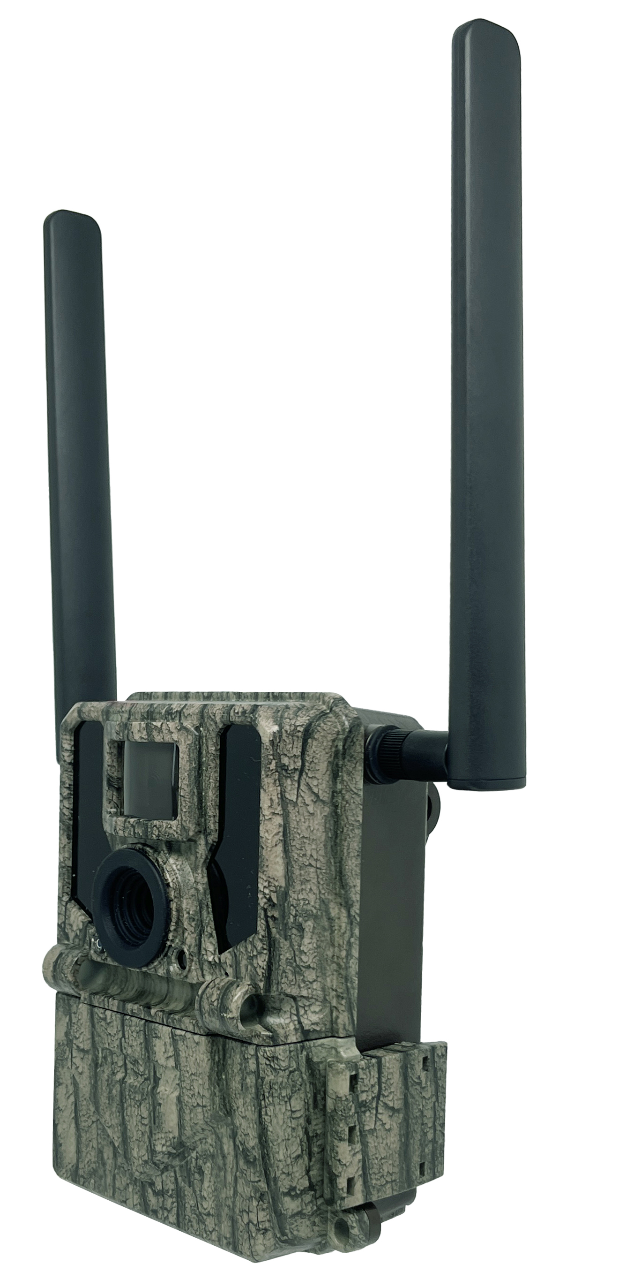
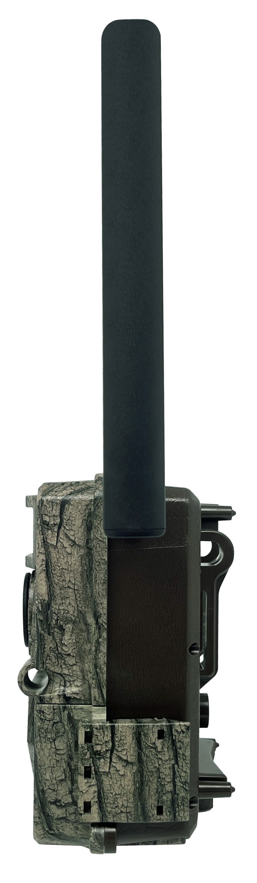
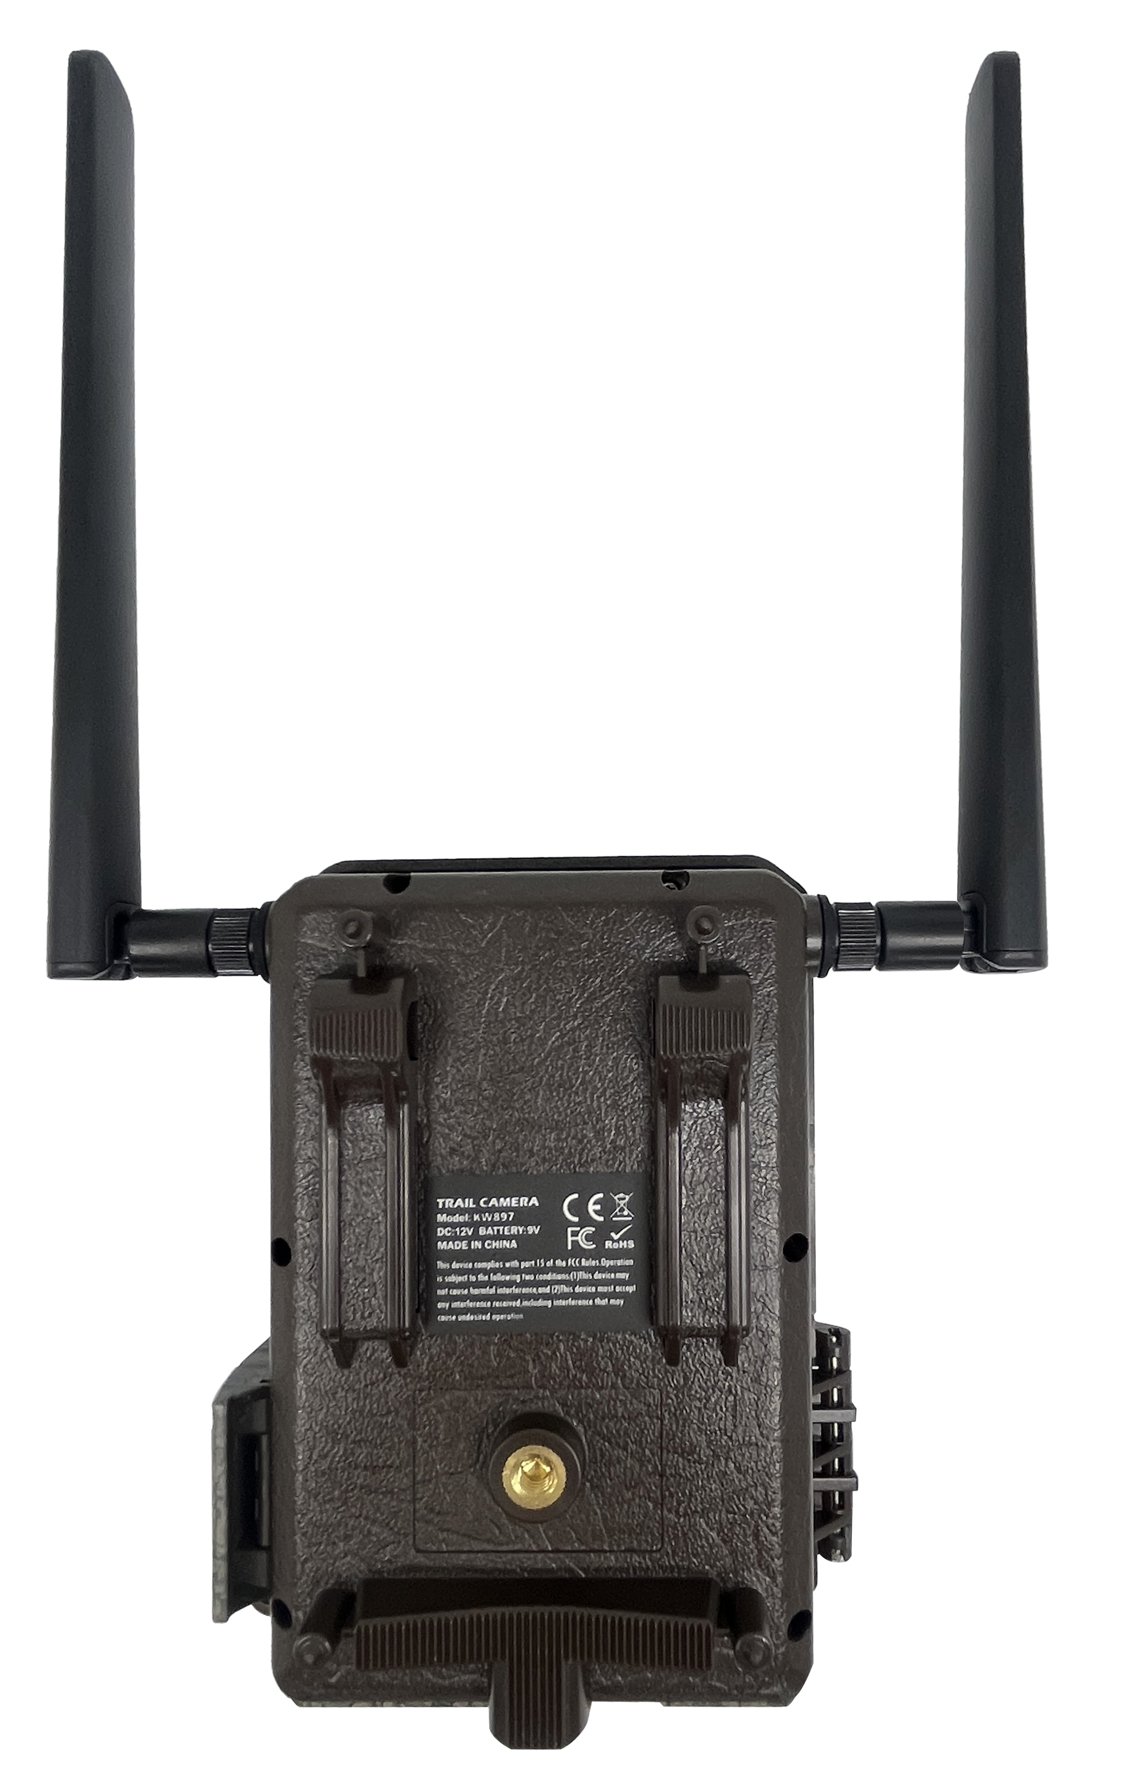
View Drawings

Slide 5
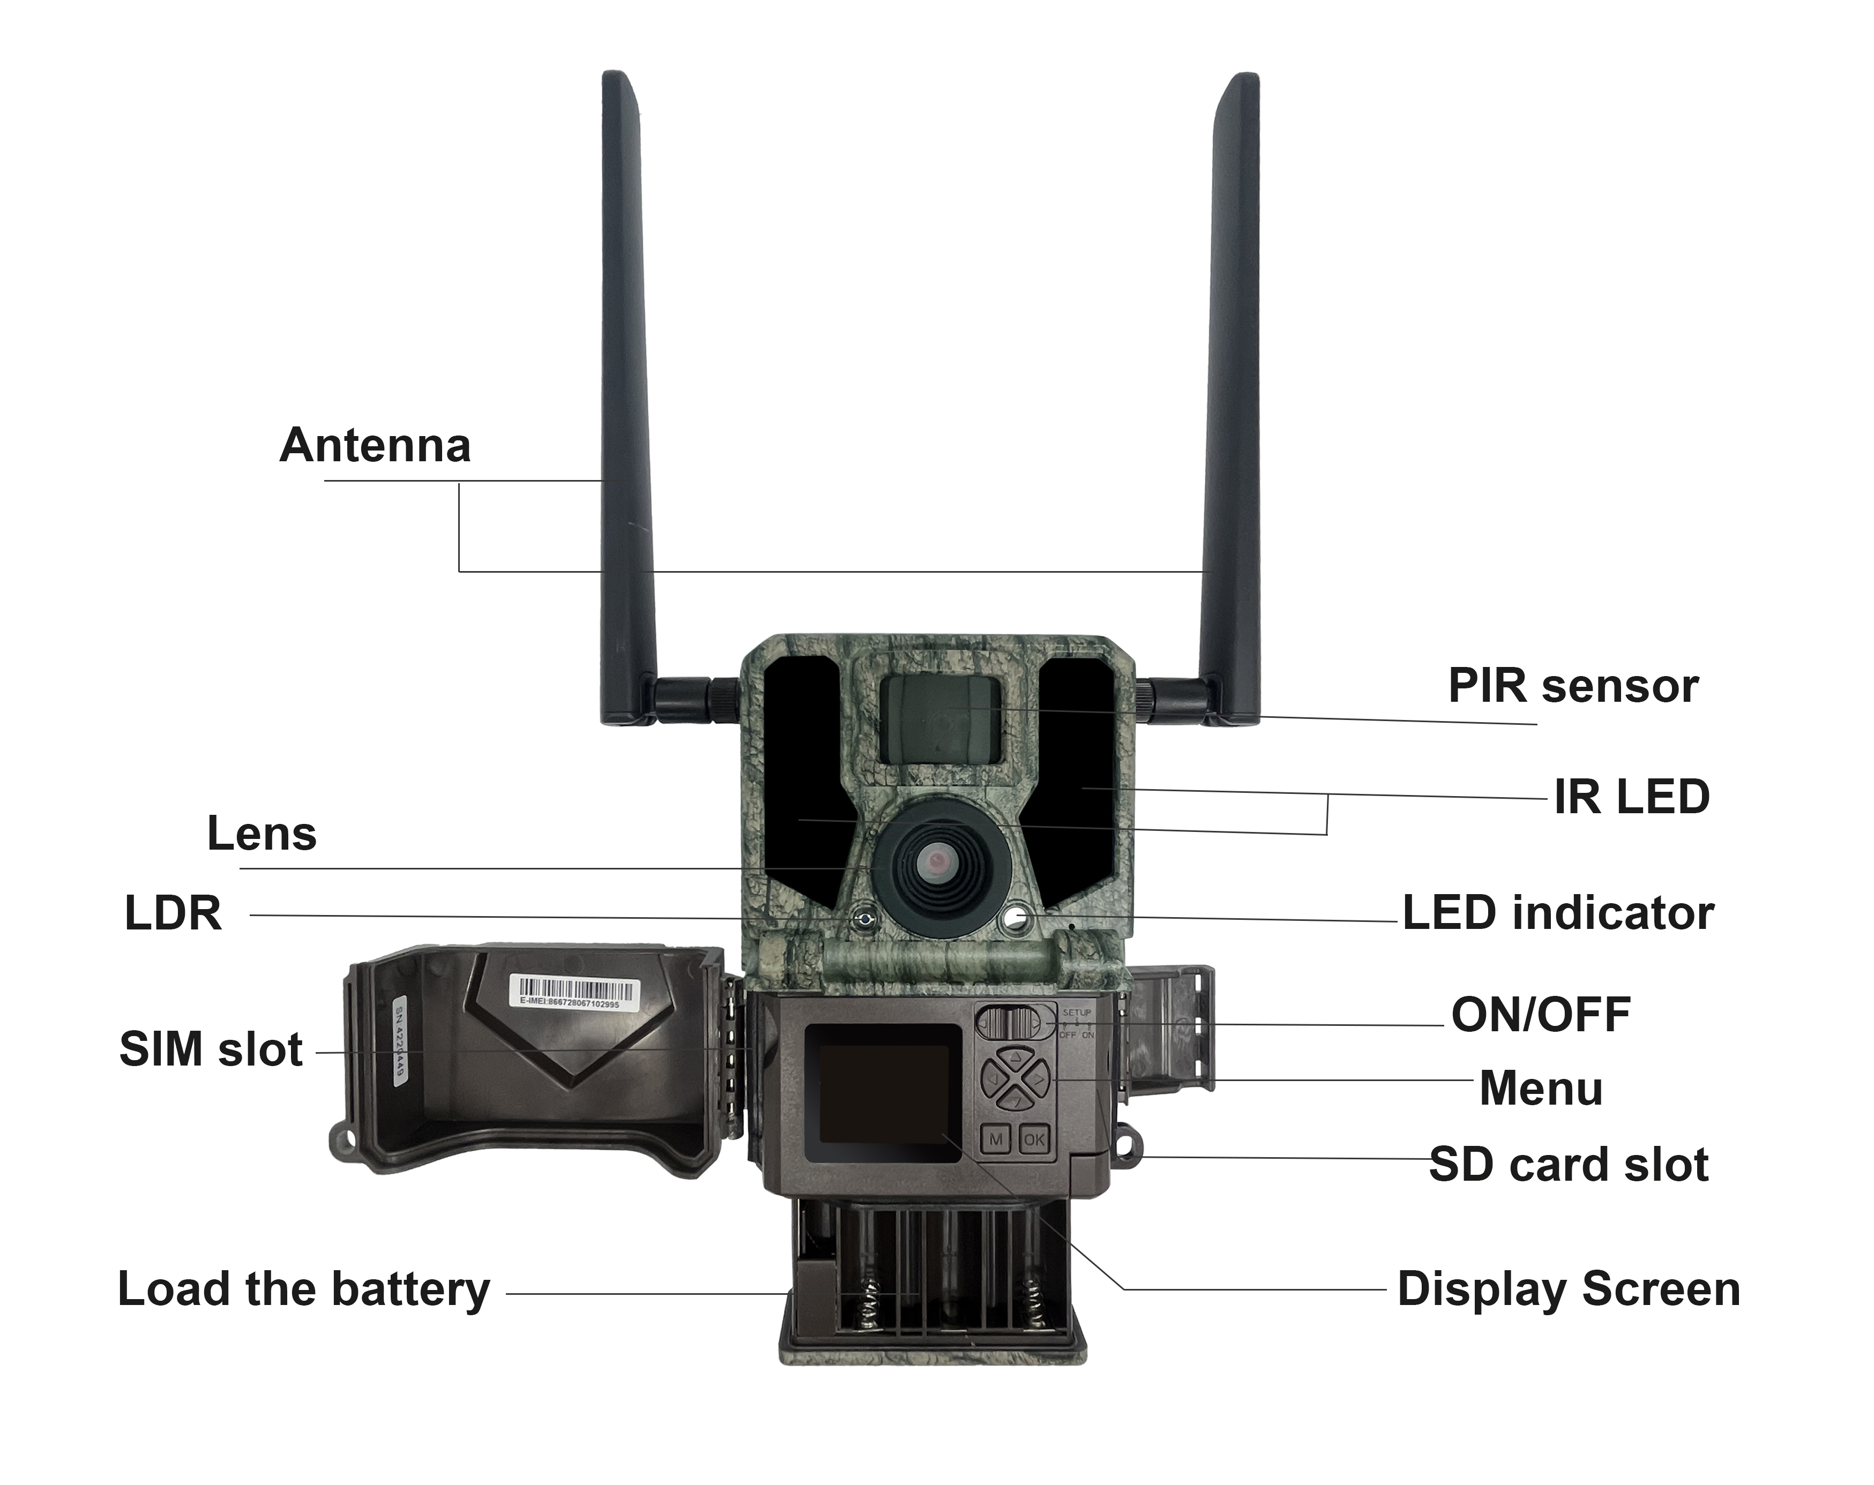
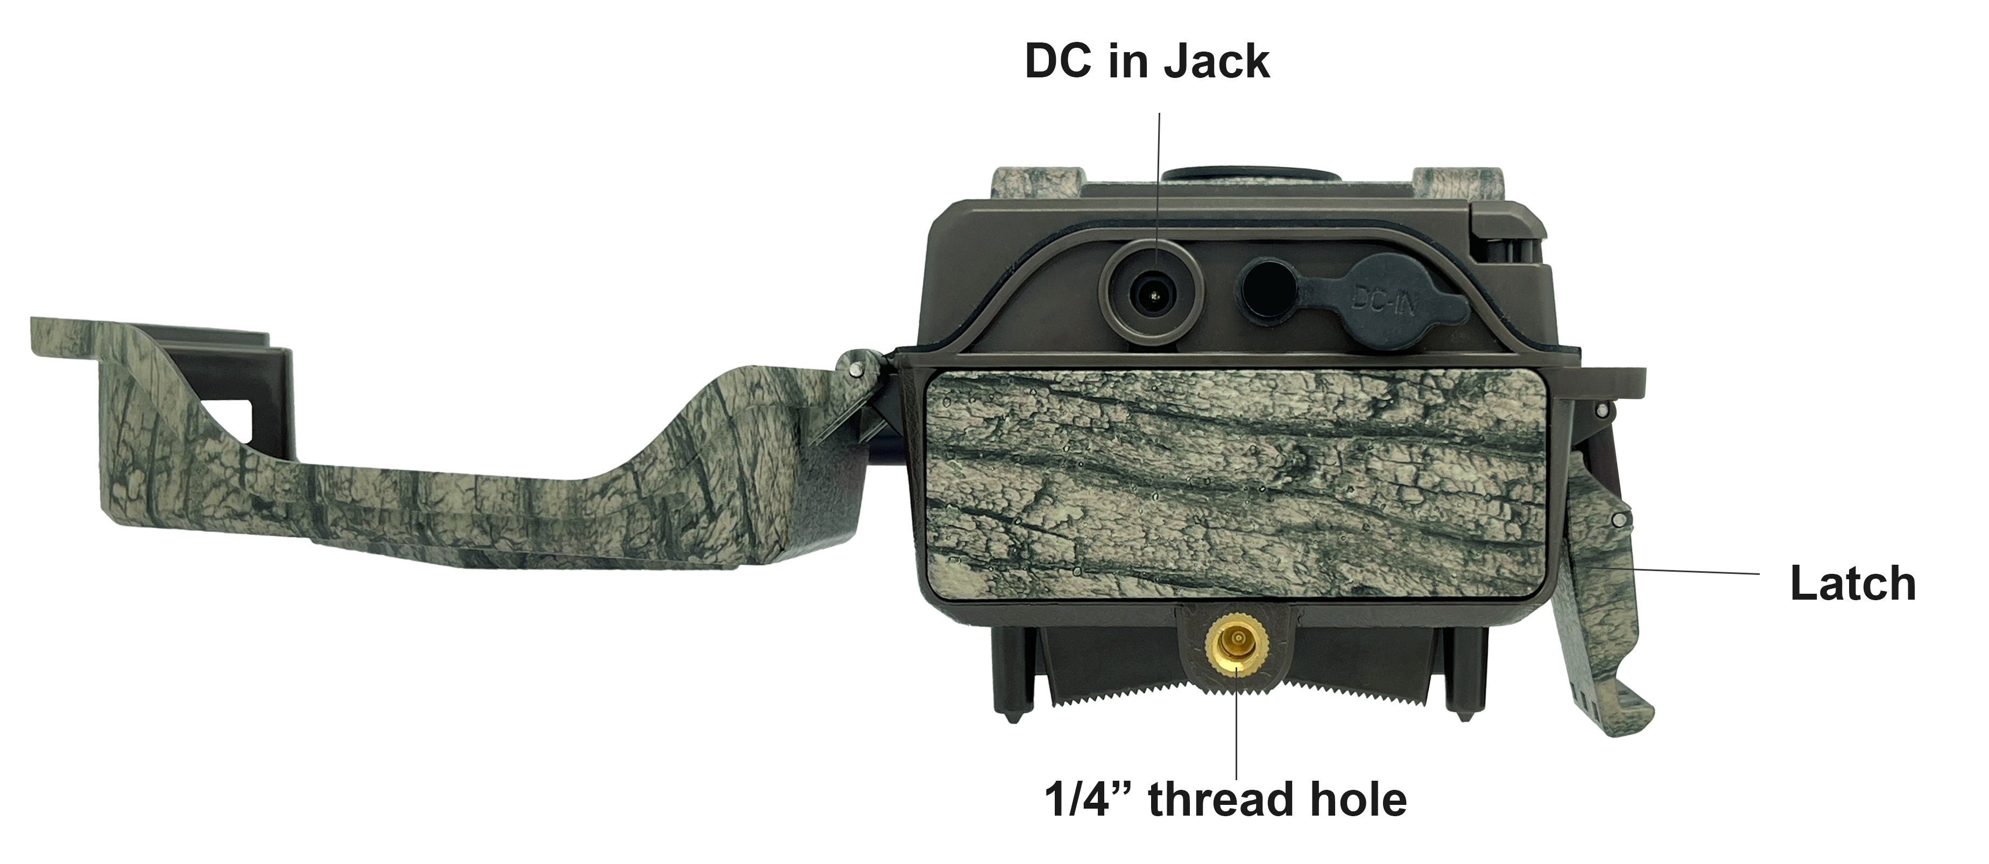
Camera Overview

Slide 6
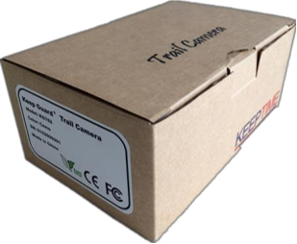
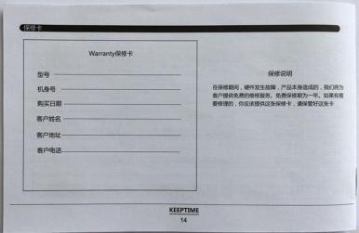
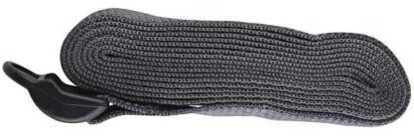
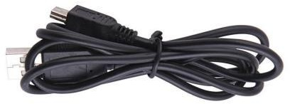

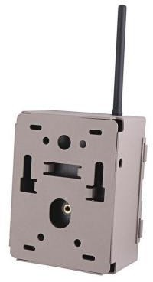
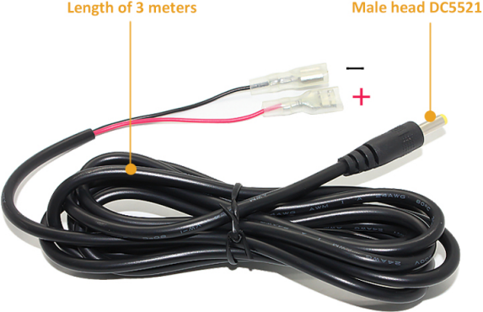

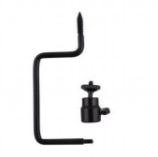
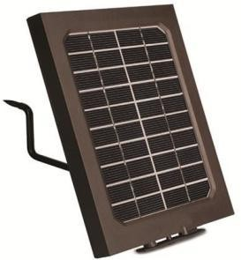
Standard Accessories
1×Belt 1×USB
Other Accessories (not included)
1×Case
1×Manual
1× Security Case
1×External battery connection wire
1×Micro-Lens 1×Wide-angel Lens
1×5M Antenna
1×Cradle Head
1×solar panel

Slide 7
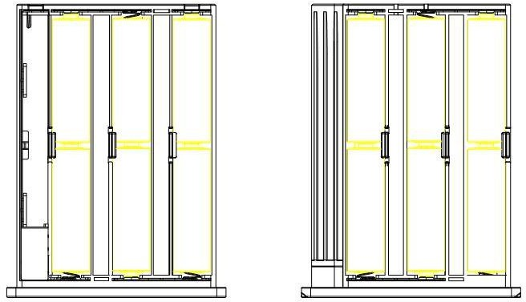
Power Supply
After opening the latch on the right side of the camera, you will see that it has 12 battery slots. For maximum battery life, we recommend using 12 lithium AA or alkaline AA batteries.
Please be sure to insert each battery with correct polarity (negative or“flat”end against the long spring of each battery slot).
SD Card / SIM Card
Insert the SD card and SIM card ( Camera being under OFF mode ) before beginning to operate the camera.

Slide 8






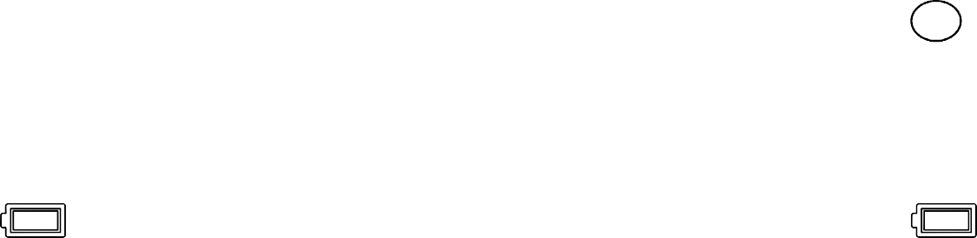
Operational Modes
The cam has three basic operational modes: 「OFF」, 「ON」 and 「SETUP」
「OFF 」Mode
When cam in OFF mode, you can do the following:
replacing the SD card or batteries
connecting cam with other device via USB port
「ON」Mode
Once in ON mode no manual controls are needed or possible (the control keys have no effect). The cam will take photos or videos automatically (according to its current parameter settings) when it is triggered by the PIR sensor′s detection of activity in the area it covers.
「SETUP」Mode
In the SETUP mode you can check and change the settings of the cam with the help of built-in LCD. Moving the power switch to the SETUP position will turn on the LCD display and you will see an information screen.
Image Resolution
Video Resolution
Available Video
Recording Time
Signal
of Photos Taken
Audio Rec ON
Camera Mode
Time Scan ON
5M
0000/0888
Video Mode
1080P
T
T
SD Card
Battery Level

Slide 9




Settings
Mode
Image Size
Picture Num
Quality
Video Size
Video Length
Image Recycle
Photo
5M
1
Fine
1920×1080
10
ON
Home
Mode | 1)Photo: Only capture pictures 2)Video: Only capture video 3)Photo+Video: Capture both pictures and videos at the same time
Image Size | Image resolution options: 5M, 20M, 36M. Higher resolution produces better quality photos, but creates larger files that take up more of the SD card capacity.
Pictures Num | Selects how many photos are taken in sequence per trigger in Camera mode.This setting affects photos taken in Field Scan mode as well.
Quality | Super Fine, Fine, Normal, select to produce the image in different quality level.
Video Resolution | 2560*1440，1920*1080，1280*720
Video Length | Sets length per captured video clip. Settings begin with 10 second default when parameter is first selected. After going down to 5s, video length choice starts over at 60s.
Image Recycle | When you turn on image recycle, it will automatically make your new file overwrite the previous files when the SD card memory is full. Please download the picture in time and choose carefully.

Slide 10


Settings
Flash Mode
PIR Interval
PIR Sensitivity
Work Time
Time Scan
LongRange
00:10
Auto
OFF
OFF
Camera Setting
Flash Mode | Select different combinations of LED illumination and shutter speed to shoot optimized photos of objects at night.
PIR Interval | You can choose 1s~59 or 1m~60m.Selects the length of time that the camera will“wait”until it responds to any additional triggers from the PIR after an animal is first detected and remains within the sensor's range. During this period of time user set“ignore triggers”interval, the camera will not capture photos/videos.This prevents the card from filling up with too many redundant images.
PIR Sensitivity | Selects the sensitivity level of the PIR motion sensor. Low, Normal, High and Auto are the options. Auto self-adjusts for differences in temperature while the other 3 options are fixed once chosen.
Work Time | Selects the time frame that the user wants the camera to capture images. Default is 24 hours. Users who may be using the camera for security purposes may only want the camera to capture images after hours for example and avoid taking images during the busy day.
Time Scan | Time Scan (Time Lapse) recording mode on/off. When activated, Time Scan forces the camera to take photos or videos even when it is not triggered by an nearby live animal,useful for constant monitoring of an area that might be far away from the camera. The user can set start and stop times for up to two in dependent “blocks”of Time Scan recording,as well as the interval time between each photo/video. Interval: 1m~59m or 1h~6h

Slide 11

Settings
Wireless 4G
Transmit Frequency
SMS Switch
Registration
IMEI
ICCID
On
Immediately
OFF
Network
Wireless 4G | This choice is about wireless function ON/OFF. If you want to send photo to you mobile phone's APP or email, please turn it on.
Transmit Frequency | This choice is about how frequently you would like the camera to send images to you. To save battery life, you may choose Weekly.
SMS Switch | When you turn SMS Switch ON, camera is standby, will excute the command from server on time. This mode consumes a lot of power.
Registration | QR code
IMEI | QR code
ICCID | QR code

Slide 12

Settings
Language
Camera Name
Password
Time Format
Data/Time
Data Stamp
EngLish
Off
24H
OFF
OFF
GPSLocation
Format
Default
Version
Setting
Language | Selects user's preferred language from all ten languages. English,French,German,Italian,Russian,Finnish,Spanish,Slovak,simplified Chinese,Chinese Traditional.
Camera Name | Select Camera Name Input to place a unique custom name on the image stamp of your camera’s images.
Password | Select”ON”If you want to protect your camera with a password. Once password is set, whenever you turn on the camera, you will need to enter a four-digit password. Select “OFF” for no protect with a password.(Please remember your password.) Once all settings are made, press OK to save.
Time Format | 24H or 12H
Data/Time | Set day and time.
Data Stamp | Selects whether the user wants to have the Time and Date stamped on images. The default mode is ON.
GPS Location | Gain camera's location information and send to server.
Format | Deletes (erases) all files stored on a card to prepare it for reuse. Always format a card that has been previously used in other devices. Press OK to execute, press MENU (or select NO then press OK) to exit without formatting.
Default | This function allows the user to revert the camera to the default settings set at the factory.
Version

Slide 13
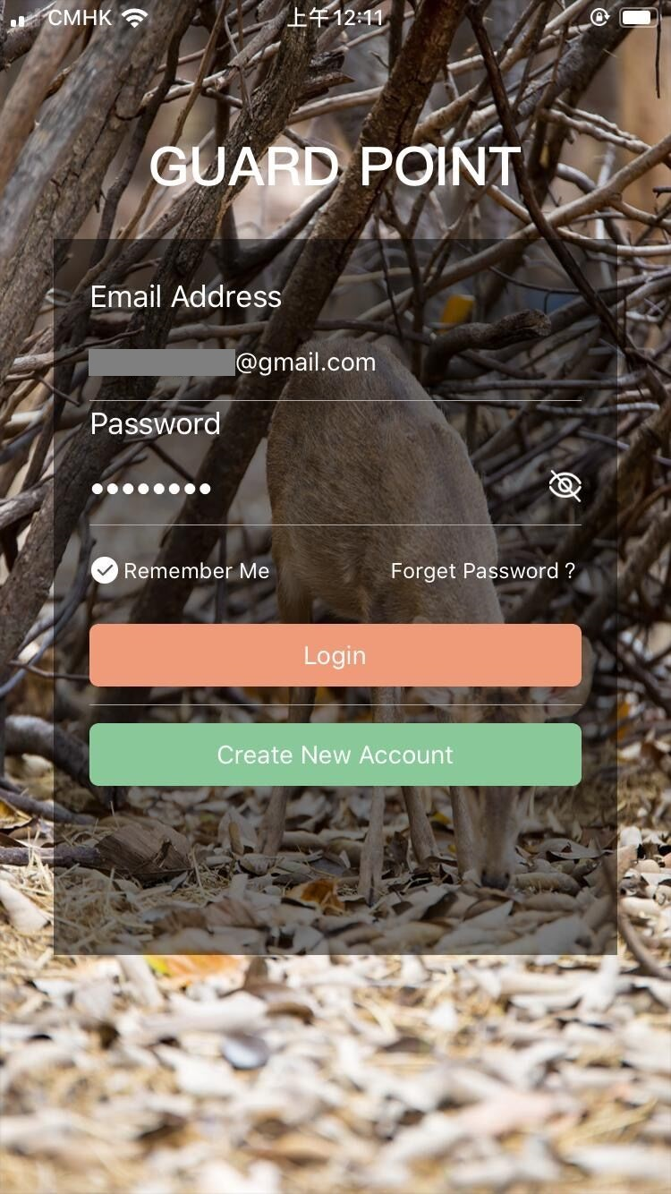
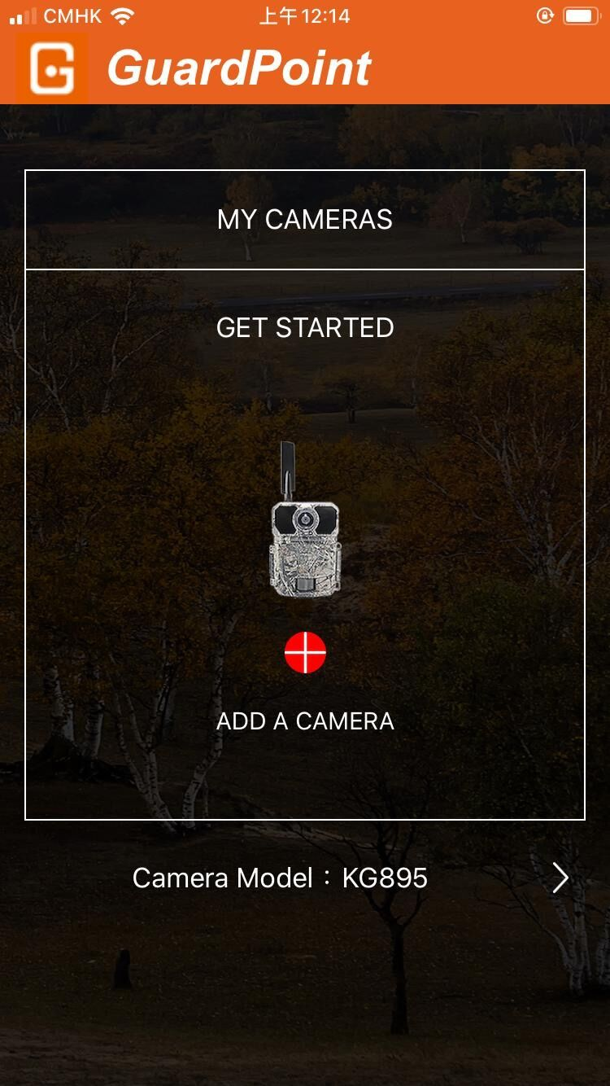


Settings in APP
1)SETUP APP
Search GUARDPOINT
in APP store, or scan below the code,then install the APP
2）Account registration
ADD A CAMERA
ISO APP
Android APP

Slide 14
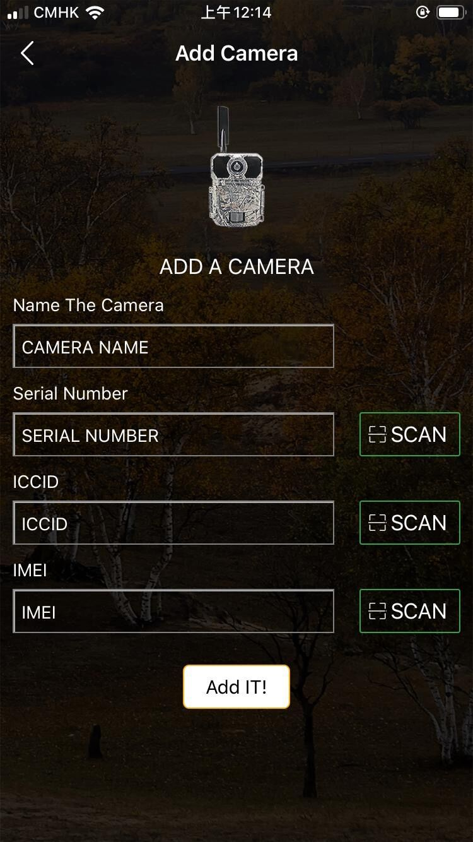
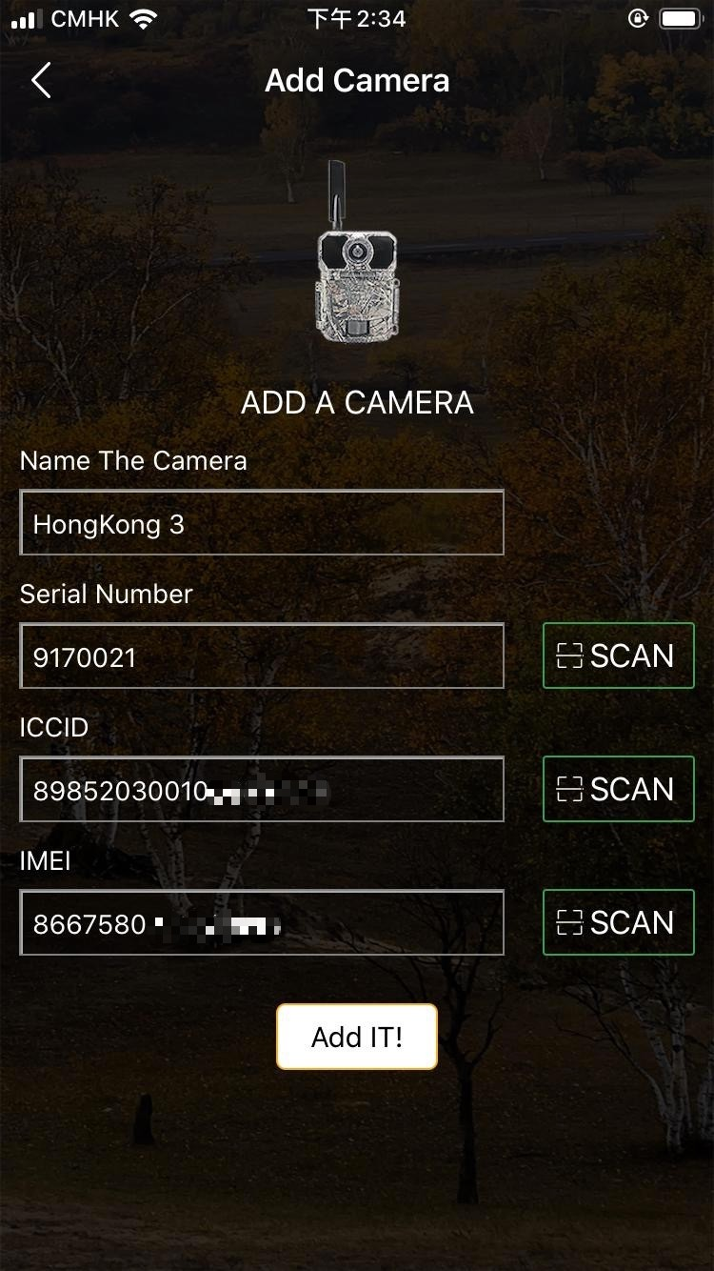


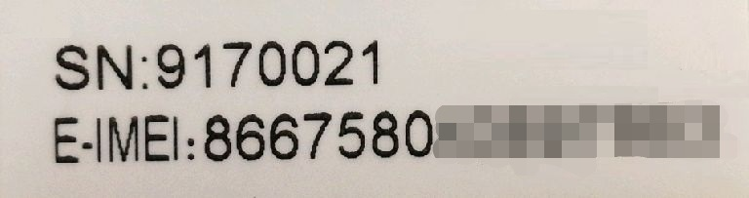
Settings in APP
3)ADD A CAMERA
FirmwareVersion
ICCID:
123456789123456789
IMEI:123456789123456
Serial Number:
Find it on the camera
ICCID:
Find it in camera's MENU
IMEI:
Find it on the camera
OK Set
MENU
Exit

Slide 15
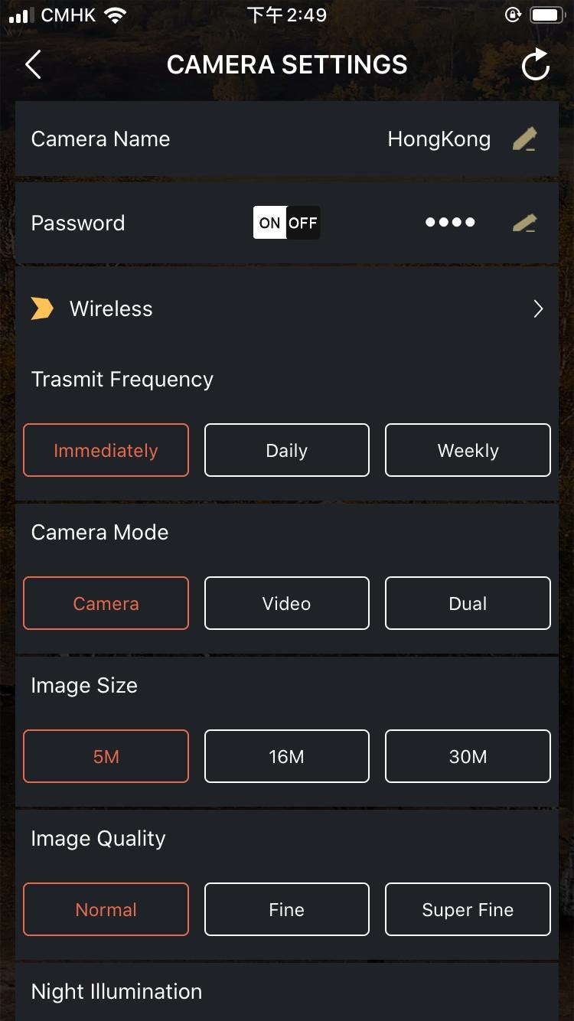
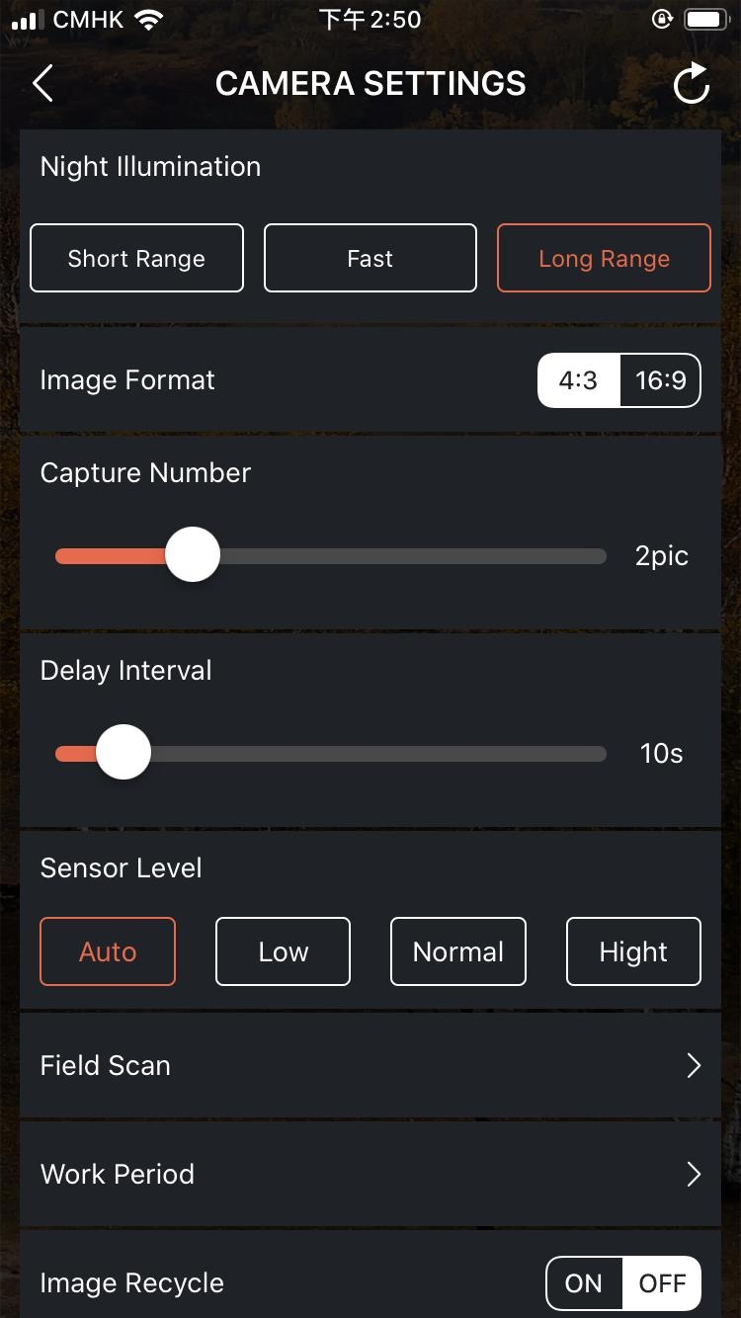
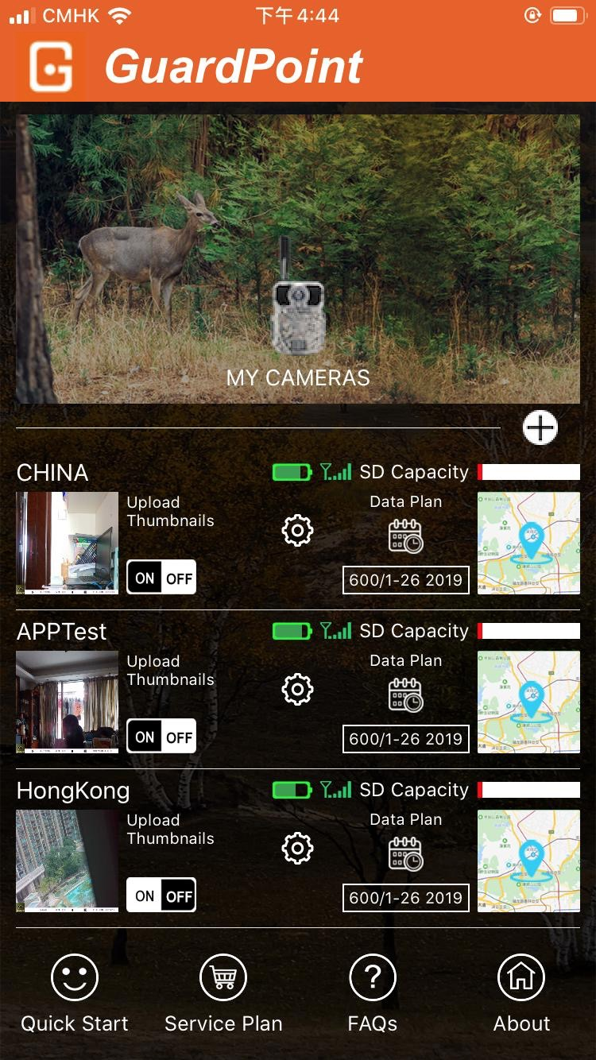
Settings in APP
4)Camera Settings
Please remember to SAVE the Settings after each modification.

Slide 16
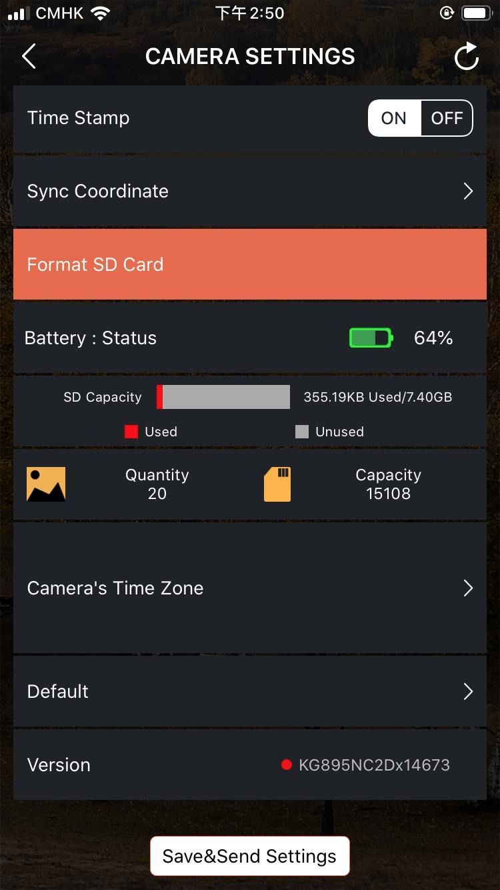
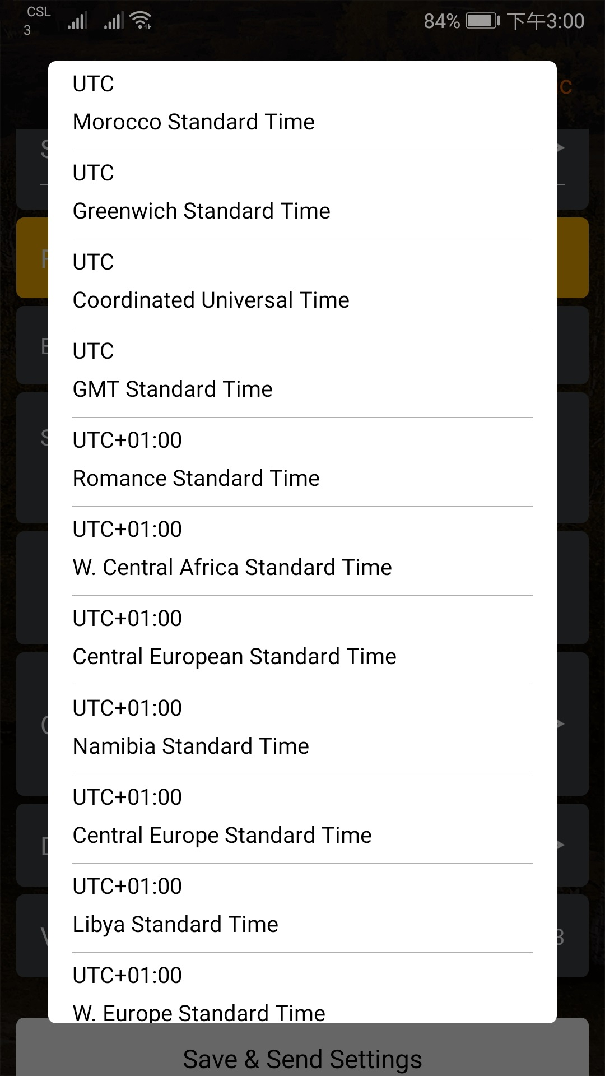
Settings in APP
Camera Settings\
Camera's Time Zone
Please select the time zone of your country.
Please remember to SAVE the Settings after each modification.

Slide 17
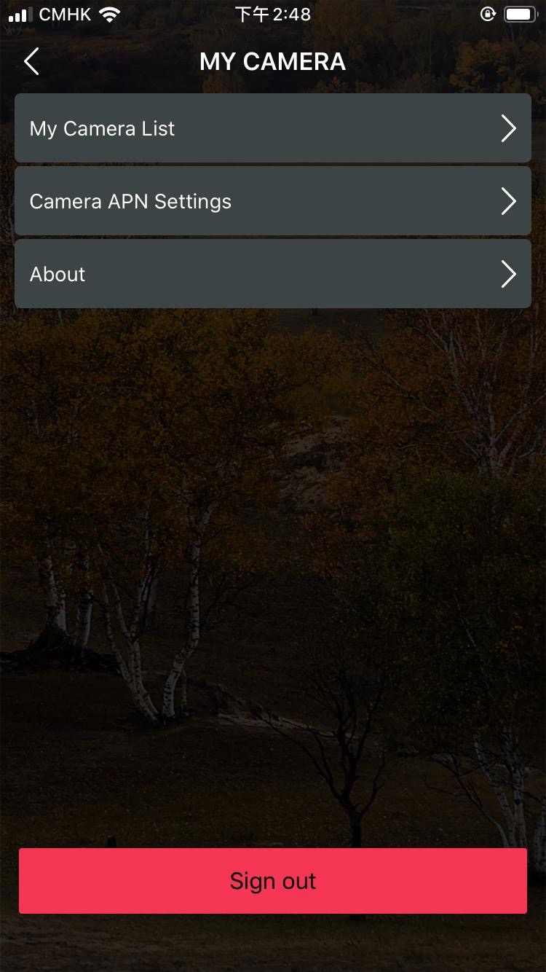
Settings in APP
5)Main Page
Quick Start
Service Plan
FAQs
About
ADD More Cameras
ON is not valid
ON is valid

Slide 18
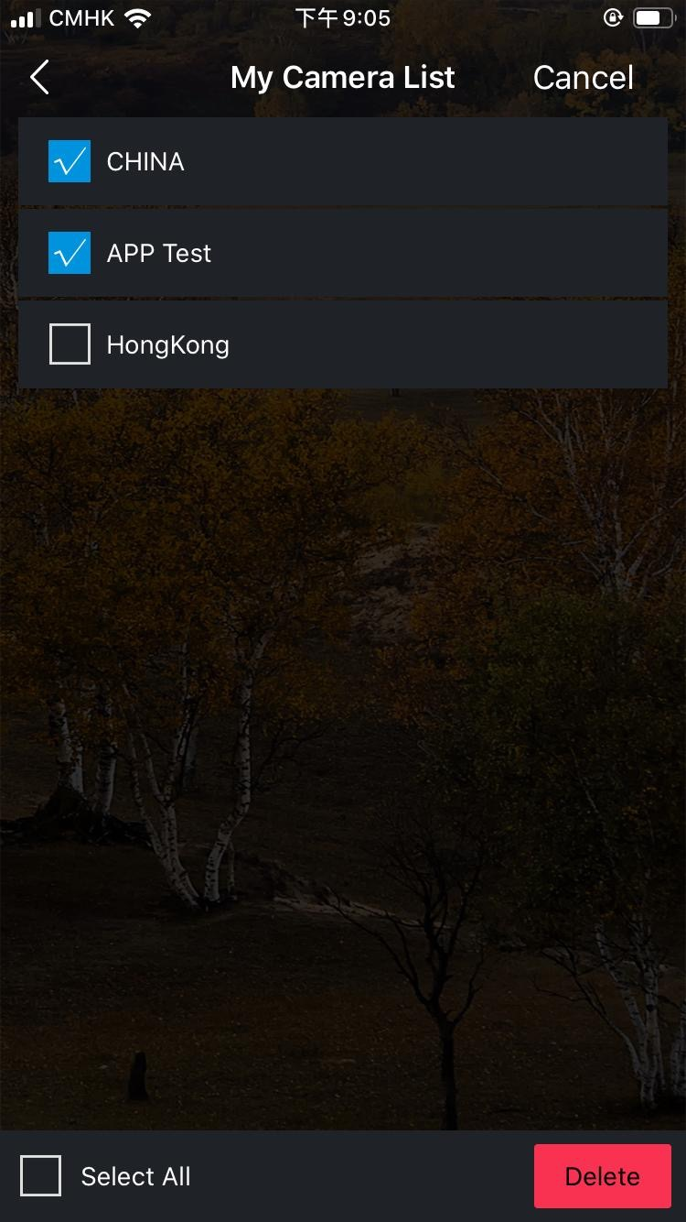
Settings in APP
6)My Camera List
When you change your phone or account, be sure to remove the unwanted camera here.
Before removing the camera, please don’t forget to download the required pictures. Otherwise, you will lose those pictures forever.

Slide 19
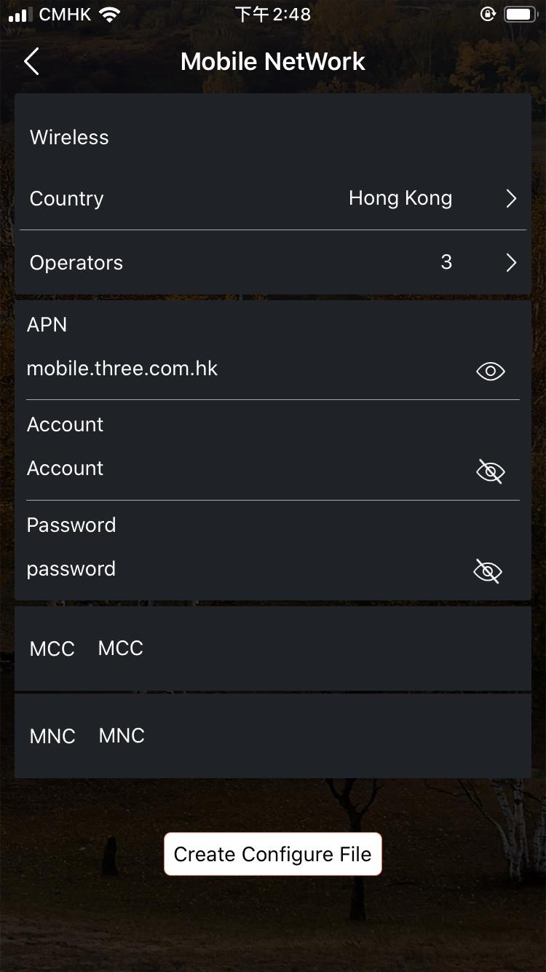
Settings in APP
7)Camera APN
Settings
If you need to add more cameras, you can quickly make a NETWORK file here, the file will be sent to your registration email, you download the file and put it on the SD card, put the SD card in the camera, you can complete the camera registration.

Slide 20
MOUNTING and POSITIONING
Mounting
Optimum height：5-6.5 inch（1.5-2 m）
Optimum distance：60inch（9m）- 10inch（3m）
There are two ways to mount cam: using the provided adjustable web belt, or the tripod socket.
Using the adjustable web belt: Push one end of the belt through the two brackets on the back of cam. Thread the end of the strap through the buckle. Fasten the belt securely around the tree trunk by pulling the end of the strap firmly so there is no slack left.
Using the tripod socket:The camera is equipped with a socket at the bottom end.
Sensing Angle and Distance Test
Totest whether cam can effectively monitor the area you choose, this test is recommended to check the sensing angle and monitoring distance of cam. Toperform the test:
Switch cam to SETUP mode.
Make movements in front of the camera at several positions within the area. Try different distances and angles from camera.
If indicator LED light flash, it indicates that position can be sensed.
The results of your testing will help you find the best place where mounting and aiming the cam. The height from the ground for placing the device should vary with animal size appropriately. In general,3 to 6 feet is preferred. You can avoid potential false triggers due to temperature and motion disturbances in front of the camera by not aiming it at a heat source or nearby tree branches or brush (especially on windy days).

Slide 21
Specification
Lens | f=7.36mm F/NO:2.8 FOV=55°; Auto IR-Cut-Remove (at night)；Support micro lens: 450mm
Trigger Time | <0.2s
Mode | Photo; Video; Photo+Video
Image Size | 5MP;20MP;36MP
Capture Number | 1-9
Video Size | 2560*1440;1920*1080；1280*720
Video Length | 5s-60s
Camera Name | Input
Interval | 1s-60m
Coordinate Input | Set it in mobile's APP
Time Stamp | On
Work Period Set | ON; OFF
Timed Scan | 2X;Interval: 1m~59m or 1h~6h
Video Sound | On
Format | Execute
Default Set | Execute
Language | English, Français, Español, Portugues, Deutsch, Italiano,Pусский, 日本語, 繁體中文, 简体中文

Slide 22
Warranty Card
Warranty
Model
Warranty State
Serial No.
During warranty, hardware failure occurring, which caused by product itself, we will provide free maintenance service for the customer. Free warranty is for the first year. If there is a need for repair, you should offer this warranty card, please take care of this card.
Date of Purchase
Your Name
Address
Tel No.

