Slide 1
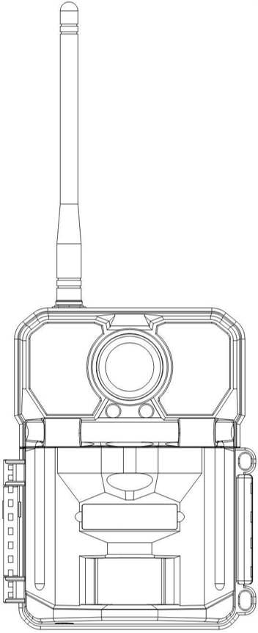
Highly Recommended by Outdoor Explorers - KW896 Advanced 4G Trail Camera Instruction Manual
Welcome to your Keepguard Trail Camera!It is the best-selling scouting camera which is designed for activity and is resistant against water and snow. It is equipped with built-in infrared sensor, so that it can be triggered accurately by heat sources, then take high quality 32MP pictures or 2K videos(Best in class). Please refer to the below notes to ensure that you are completely satisfied with this product.
Contents
Camera Overview
View Drawings
Quick Start
Notes Before Use
Accessories
Operational Modes
Settings
Setting in APP
Mounting and Positioning
Specification
Warranty Card
2
3
4
5
6
7
8-13
14-19
20
21
22

Slide 2
Camera Overview

Slide 3
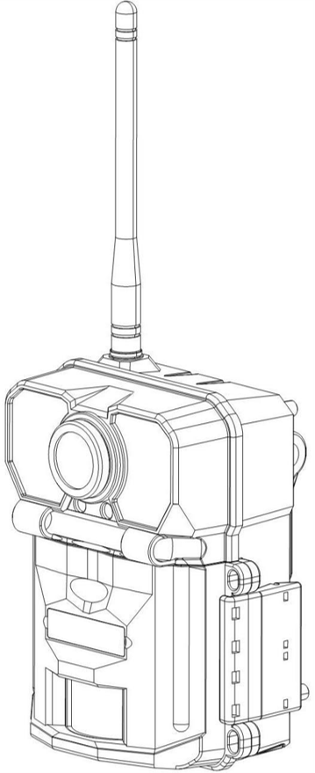
View Drawings

Slide 4
Quick Start Guide
1.Download the free App Guard Point on your smartphone from the App Store(iPhone) or Google Play(Android).
2.Open the Guard Point App,then sign in or create a new account.
3.Log in and click “+”to add a new camera.Scan the QR code on the camera menu Registering to associate this camera with your account.
4.Install 12 AA batteries(Rechargeable batteries are not recommended).Be sure to position the batteries for correct polarity (+-) when installing.
5.Install a new SD card,up to 512GB.High speed cards(Class 10 or higher) are recommended if you plan to record video clips.
6.The camera KW896 is equipped with Sim card and it will automatically connect to the carrier with the strongest service each time the camera is powered on.
7.Switch to the SETUP Mode,wait about 1Minute.
8.Press " UP " key to select Video Mode;Press “Down” key to select Photo Mode.
9.Press " LEFT" key to take a photo/Video and send it to your APP.
10. Switch to the ON Mode
11. Close the case and position the camera for use

Slide 5
Notes Before Use
When setting camera parameters, please put camera in Setup mode.
Do not set the camera directly from ON to Setup.
To replace the battery, SD card, and SIM card, firstly turn camera to OFF mode.
Color of Indicator
When camera is updating firmware, indicator light flashes green.
The indicator light flashes red when it is turned on or ready for operation.
low battery, the indicator light flashes blue.
long standby time, the indicator flashes purple.
When the SD card is inserted into camera, make sure that the SD card is not in lock state.
When using an external power supply, make sure that voltage is 12V.
Please take out the battery to avoid leakage of the battery if camera is not used for a long time.
Camera can not be directly immersed in water, can not be placed in the environment of strong acid and alkali.
Don’t use your fingers to press the Fresnel lens.
Keep the lens and battery compartment clean.
Do not use sharp hard objects to scratch screen.

Slide 6
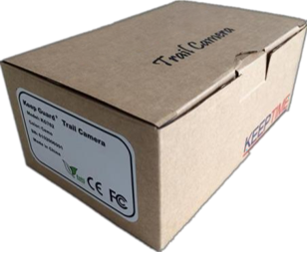
Standard Accessories
1×Belt 1×USB
Other Accessories (not included)
1×Case
1×Manual
1× Security Case
1×External battery connection wire
1×Micro-Lens 1×Wide-angel Lens
1×5M Antenna
1×Cradle Head
1×solar panel

Slide 7
Operational Modes
The cam has three basic operational modes: 「OFF」, 「ON」 and 「SETUP」
「OFF 」Mode
When cam in OFF mode, you can do the following:
replacing the SD card or batteries
connecting cam with other device via USB port
「ON」Mode
Once in ON mode no manual controls are needed or possible (the control keys have no effect). The cam will take photos or videos automatically (according to its current parameter settings) when it is triggered by the PIR sensor′s detection of activity in the area it covers.
「SETUP」Mode
In the SETUP mode you can check and change the settings of the cam with the help of built-in LCD. Moving the power switch to the SETUP position will turn on the LCD display and you will see an information screen.
Image Resolution
Video Resolution
Available Video
Recording Time
Signal
of Photos Taken
Audio Rec ON
Camera Mode
Time Stamp ON
5M
0000/0888
Video Mode
1080P
T
T
Time Scan ON
SD Card
Battery Level

Slide 8
Settings
Set Clock
Set
Mode: Photo, Video, Dual
Flash Mode:Long Range,Motion Fast,Short Range
PIR Interval: Defaulted 30seconds, optional from 10seconds to 60minutes. The camera won't record any image or videos during the selected interval.
PIR Sensitivity: High, Medium, Low,Auto
Worke Time: ON,OFF
When select ON mode, camera only active within a certain time.E.g.: Set start time to 17:35 and end time to 7:25, the camera will be operational from 5:35pm of the current day until 7:25 am of the next day. Camera won't be triggered and won't take any photos/videos outside of this period.
OK Set
MENU
Exit
Mode
Camera
Video Dual
OK Set
MENU
Exit
Image Size
5M
16M
30M
OK Set
MENU
Exit

Slide 9
Settings
Set Clock
Set
Time Scan: ON,OFF(optional from 5 seconds to 24 hours)
When selected on, the camera will take photo/video automatically in the selected time regardless of whether the PIR sensor has detected a motion or not.Note: In this mode, PIR function still working, camera will take photo/video in the iterval time when PIR sensor detects a motion.
PIR Switch: ON,OFF
Wireless 4G:ON,OFF
Short message wakeup: ON,OFF
Transmit Frequency: immediately,Daily,Weekly
Send Video Option: VGA
OK Set
MENU
Exit
Mode
Camera
Video Dual
OK Set
MENU
Exit
Image Size
5M
16M
30M
OK Set
MENU
Exit

Slide 10
Settings
Set Clock
Set
IMEI : QR Code IMEI
ICCID:QR Code ICCID
Registering:QR Code Register
Scan the QR code to associate this camera with your account.
OK Set
MENU
Exit
Mode
Camera
Video Dual
OK Set
MENU
Exit
Image Size
5M
16M
30M
OK Set
MENU
Exit

Slide 11
Settings
Set Clock
Set
Resolution: 32M,16M,4M
Picture Number: 1-9 photos. Select the number of photos to be taken in succesion.( Available on Photo mode)
Quality: Super Fine,Fine,Normal
OK Set
MENU
Exit
Mode
Camera
Video Dual
OK Set
MENU
Exit
Image Size
Resolution: 2560*1440,1920*1080,1280*720
Video Length: 5-60 seconds
Specify the duration of a video recording when the camera is triggered automatically. Video's recording period won't be limited in Setup mode.
Record Audio: ON,OFF
5M
16M
30M
OK Set
MENU
Exit

Slide 12
Settings
Set Clock
Set
Date/Time: Set day and time
Language: English,French,Spanish, Portuguese, German,Italian, Simplified Chinese,Chinese Traditional, Russian, Japanese.
Format: Press “OK” to format the SD card, all files will be delected by formatting.
Loop recording:ON,OFF.
Camera Name: Allows you to enter up to 12 characters of your choice to identify this camera.Especially useful for multi-camera setups.This will be imprinted on each photo.Default name is “KW896”.
Password Setting: ON,OFF.
Select “On” will enter a four-digit password to protect your camera against unauthorised access. This password must be inputed everytime when user want to open the camera.
OK Set
MENU
Exit
Mode
Camera
Video Dual
OK Set
MENU
Exit
Image Size
5M
16M
30M
OK Set
MENU
Exit

Slide 13
Settings
Set Clock
Set
Date Stamp: The date and time will be set once the camera has connected to the server and will be imprinted on all images.
GPS_COORD:ON,OFF.
Time Format: 24H/12H
Default Setting: Press “OK” to reset the camera to default setting.
MCUFW Update: You will get firmware here.
Version: You can check your camera's version here.
OK Set
MENU
Exit
Mode
Camera
Video Dual
OK Set
MENU
Exit
Image Size
5M
16M
30M
OK Set
MENU
Exit

Slide 14
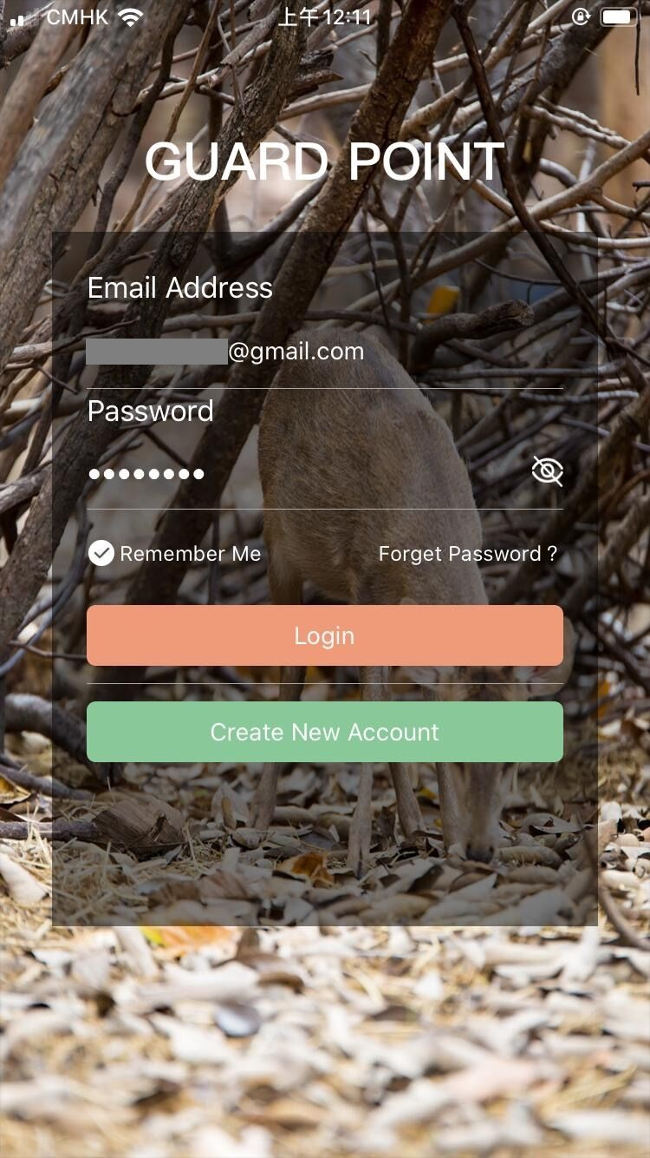
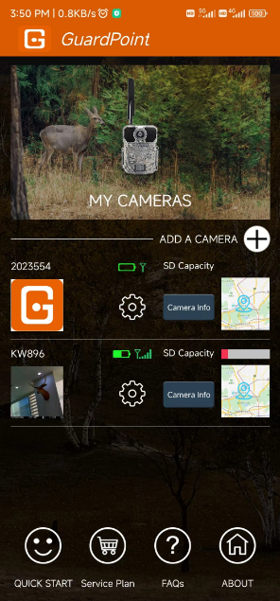
Settings in APP
1)SETUP APP
Search GUARDPOINT
in APP store, or scan below the code,then install the APP
2）Account Registration
ADD A CAMERA
ISO APP
Android APP

Slide 15
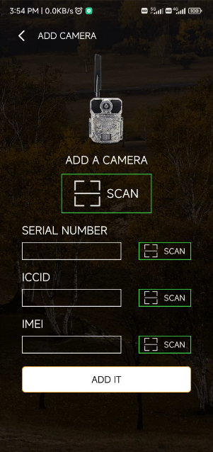
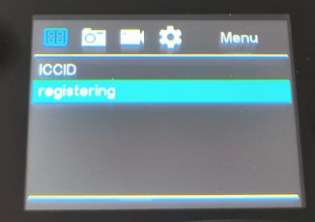
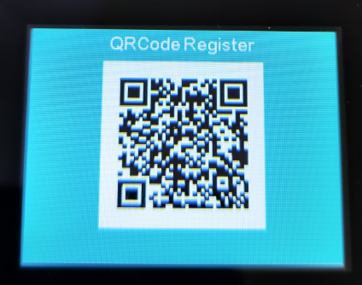
Settings in APP
3)ADD A CAMERA
Scan the QR code on the camera menu Registering to associate this camera with your account.
You also can manually enter its serial #,ICCID,IMEI to associate this camera one by one.

Slide 16
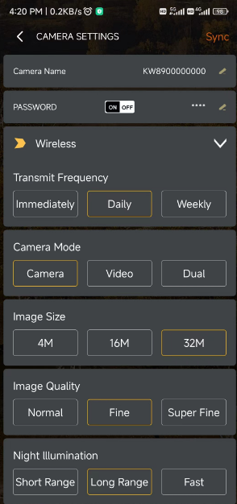
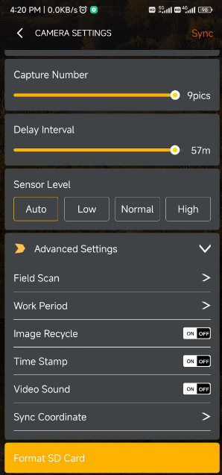
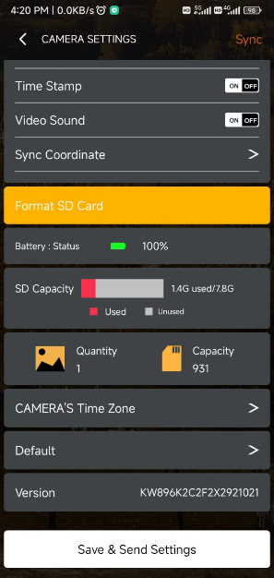
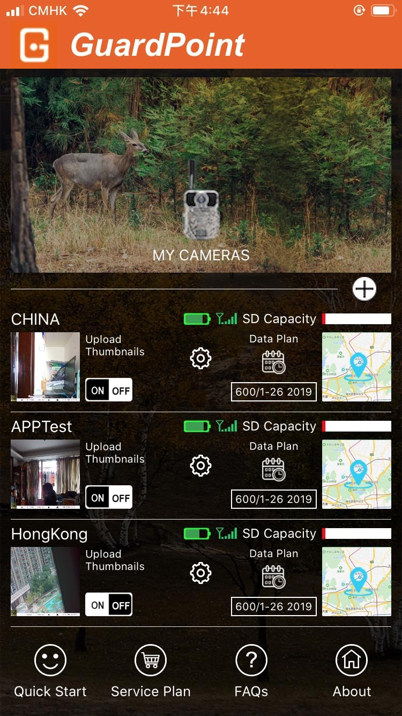
Settings in APP
4)Camera Settings
Please remember to SAVE the Settings after each modification.

Slide 17
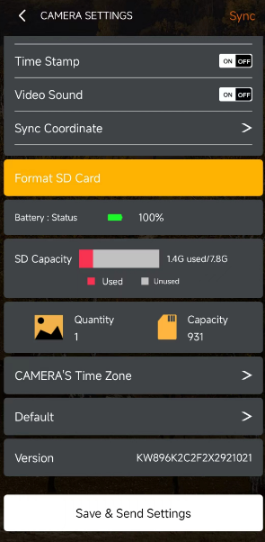
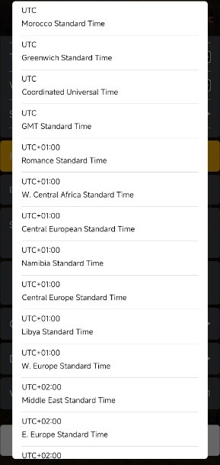
Settings in APP
Camera Settings\
Camera's Time Zone
Please select the time zone of your country.
Please remember to SAVE the Settings after each modification.

Slide 18
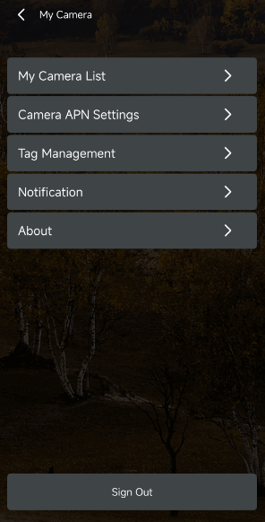
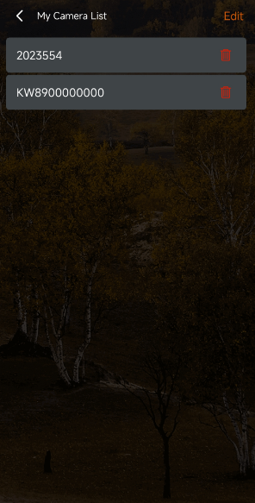
Settings in APP
5)My Camera List
When you change your phone or account, be sure to remove the unwanted camera here.
Before removing the camera, please don’t forget to download the required pictures. Otherwise, you will lose those pictures forever.

Slide 19
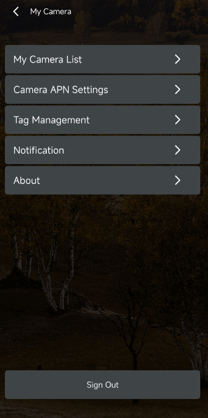
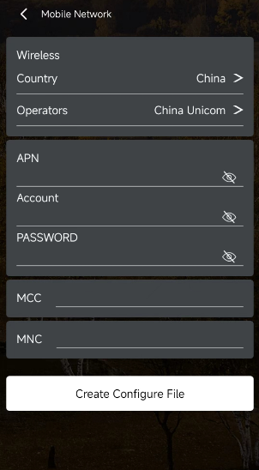
Settings in APP
6)Camera APN
Settings
If you need to add more cameras, you can quickly make a NETWORK file here, the file will be sent to your registration email, you download the file and put it on the SD card, put the SD card in the camera, you can complete the camera registration.

Slide 20
MOUNTING and POSITIONING
Mounting
Optimum height：5-6.5 inch（1.5-2 m）
Optimum distance：60inch（9m）- 10inch（3m）
There are two ways to mount cam: using the provided adjustable web belt, or the tripod socket.
Using the adjustable web belt: Push one end of the belt through the two brackets on the back of cam. Thread the end of the strap through the buckle. Fasten the belt securely around the tree trunk by pulling the end of the strap firmly so there is no slack left.
Using the tripod socket:The camera is equipped with a socket at the bottom end.
Sensing Angle and Distance Test
Totest whether cam can effectively monitor the area you choose, this test is recommended to check the sensing angle and monitoring distance of cam. Toperform the test:
Switch cam to SETUP mode.
Make movements in front of the camera at several positions within the area. Try different distances and angles from camera.
If indicator LED light flash, it indicates that position can be sensed.
The results of your testing will help you find the best place where mounting and aiming the cam. The height from the ground for placing the device should vary with animal size appropriately. In general,3 to 6 feet is preferred. You can avoid potential false triggers due to temperature and motion disturbances in front of the camera by not aiming it at a heat source or nearby tree branches or brush (especially on windy days).

Slide 21
Specification
Lens | f=7.36mm F/NO:2.8 FOV=55°; Auto IR-Cut-Remove (at night)；Support micro lens: 450mm
Trigger Time | <0.25s
Mode | Camera; Video; Dual
Image Size | 4MP;16MP;32MP
Capture Number | 1-9
Video Size | 1280*720;1920*1080;2560*1440
Video Length | 5s-60s
Camera Name | Input
Interval | 1s-60m
Coordinate Input | Set it in mobile's APP
Time Stamp | On
Work Period Set | ON; OFF
Timed Scan | 2X;Interval: 1m~59m or 1h~6h
Video Sound | On
Format | Execute
Default Set | Execute
Language | English, Français, Español, Deutsch, Italiano,Pусский, Suomalainen, Slovak,Turkish,繁體中文, 简体中文

Slide 22
Warranty Card
Warranty
Model
Warranty State
Serial No.
During warranty, hardware failure occurring, which caused by product itself, we will provide free maintenance service for the customer. Free warranty is for the first year. If there is a need for repair, you should offer this warranty card, please take care of this card.
Date of Purchase
Your Name
Address
Tel No.

